Slide 1
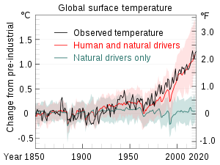
Attribution of climate change: identify mechanisms

Slide 2
Climate projections into the future
Temperature
+1,5°C
+2,0°C
+4,0°C
IPCC, AR6 (2021)

Slide 3
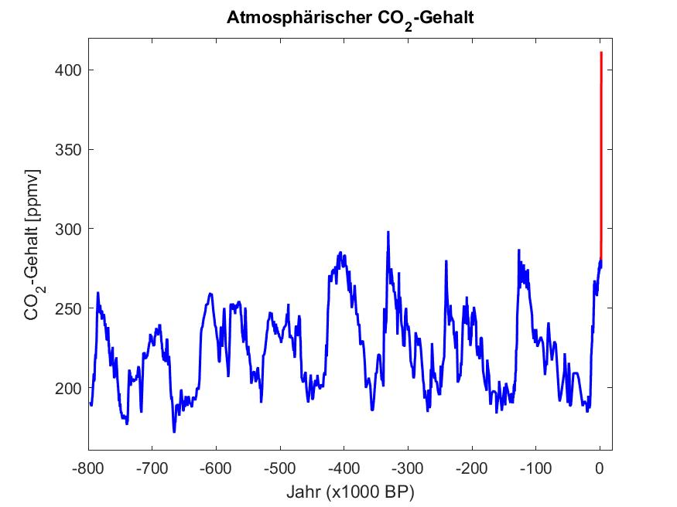
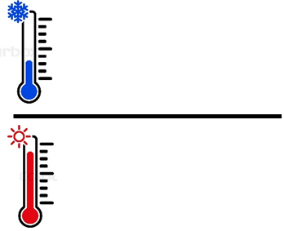
Atmospheric CO₂
430
Interglacials
Ice ages

Slide 4
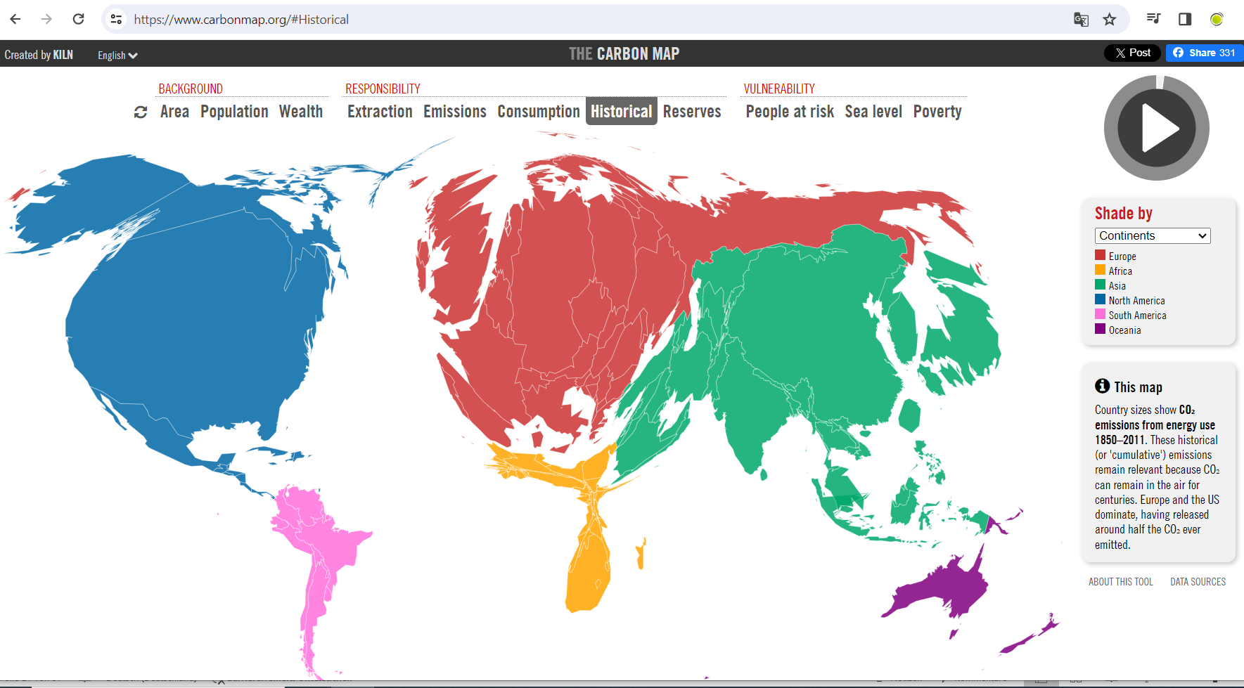
Country sizes show CO₂ emissions from energy use 1850–2011. These historical (or 'cumulative') emissions remain relevant because CO₂ can remain in the air for centuries. Europe and the US dominate, having released around half the CO₂ ever emitted.
carbonmap.org
Notes:
die Regenzeiten werden immer kürzer und schwieriger
nur zwölf Prozent der Böden für den Anbau geeignet ist, aber 80 Prozent der Bevölkerung von der Landwirtschaft leben
Die Niederschläge werden heftiger, aber dadurch fällt nicht etwa mehr Regen in der ganzen Saison. Die Jahressummen waren zuletzt annähernd gleich. Das bedeutet: Der Regen verteilt sich auf weniger Tage, und die Pausen dazwischen werden größer. Dadurch können die Böden leichter austrocknen.“

Slide 5
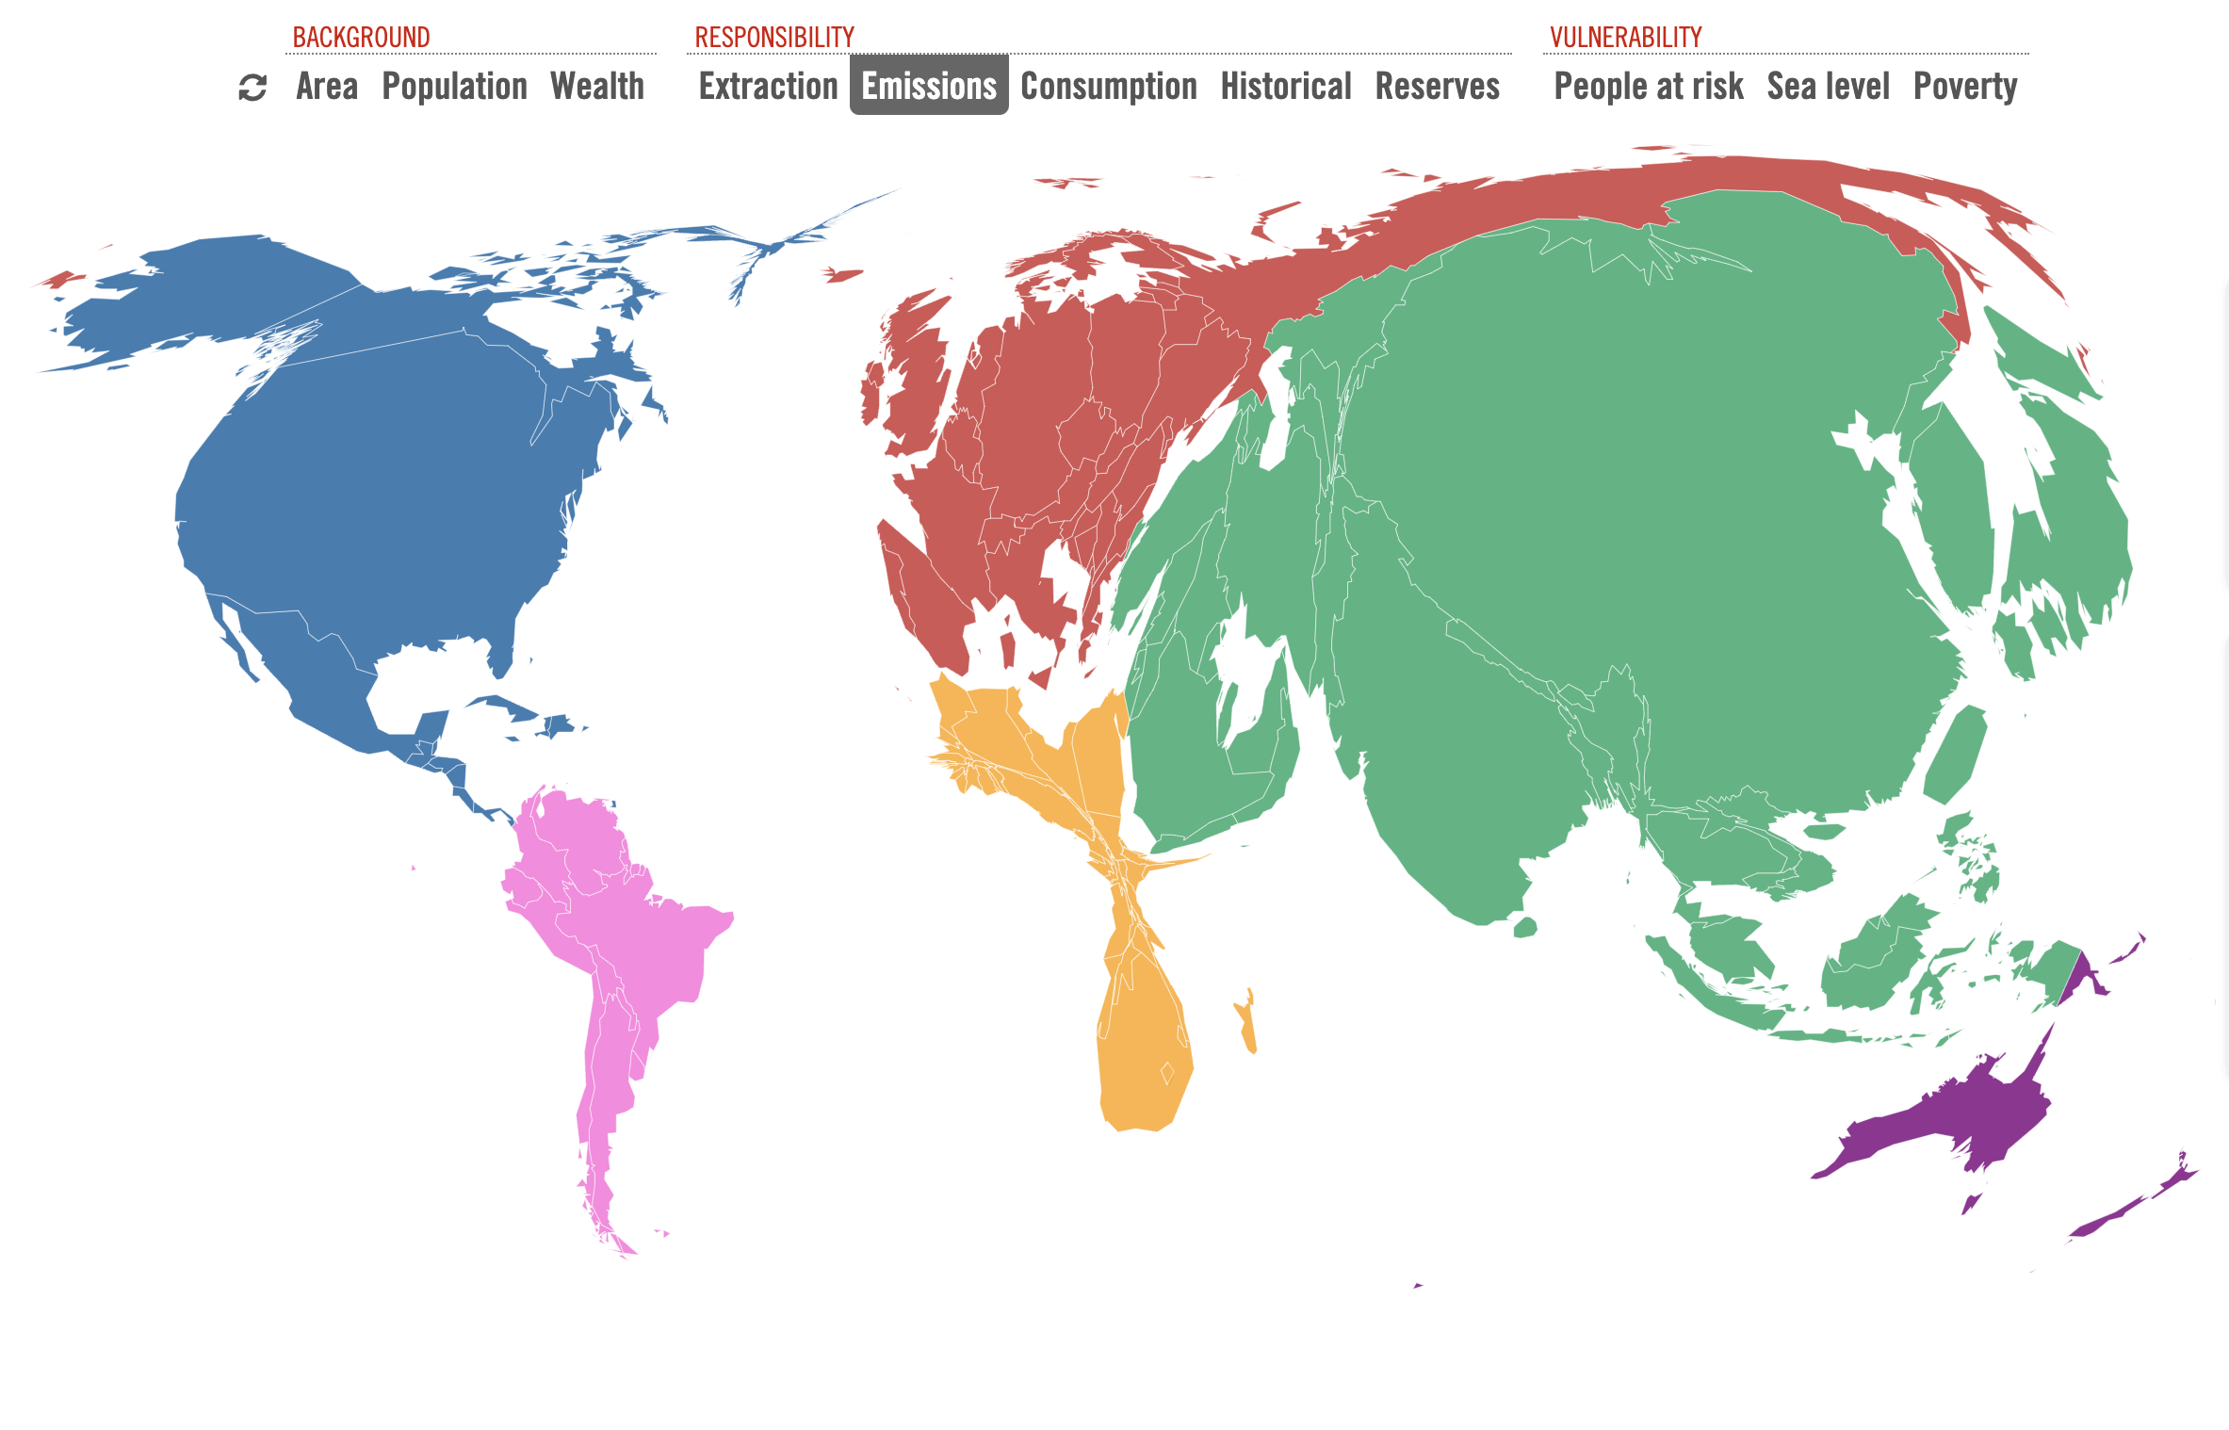
Countries are sized to show their annual CO₂ emissions from fossil fuel use and cement production (2013).
This is the conventional way to view national emissions, but it ignores imports and exports of fossil fuels (the Extraction map) and goods and services (the Consumption map).

Slide 6
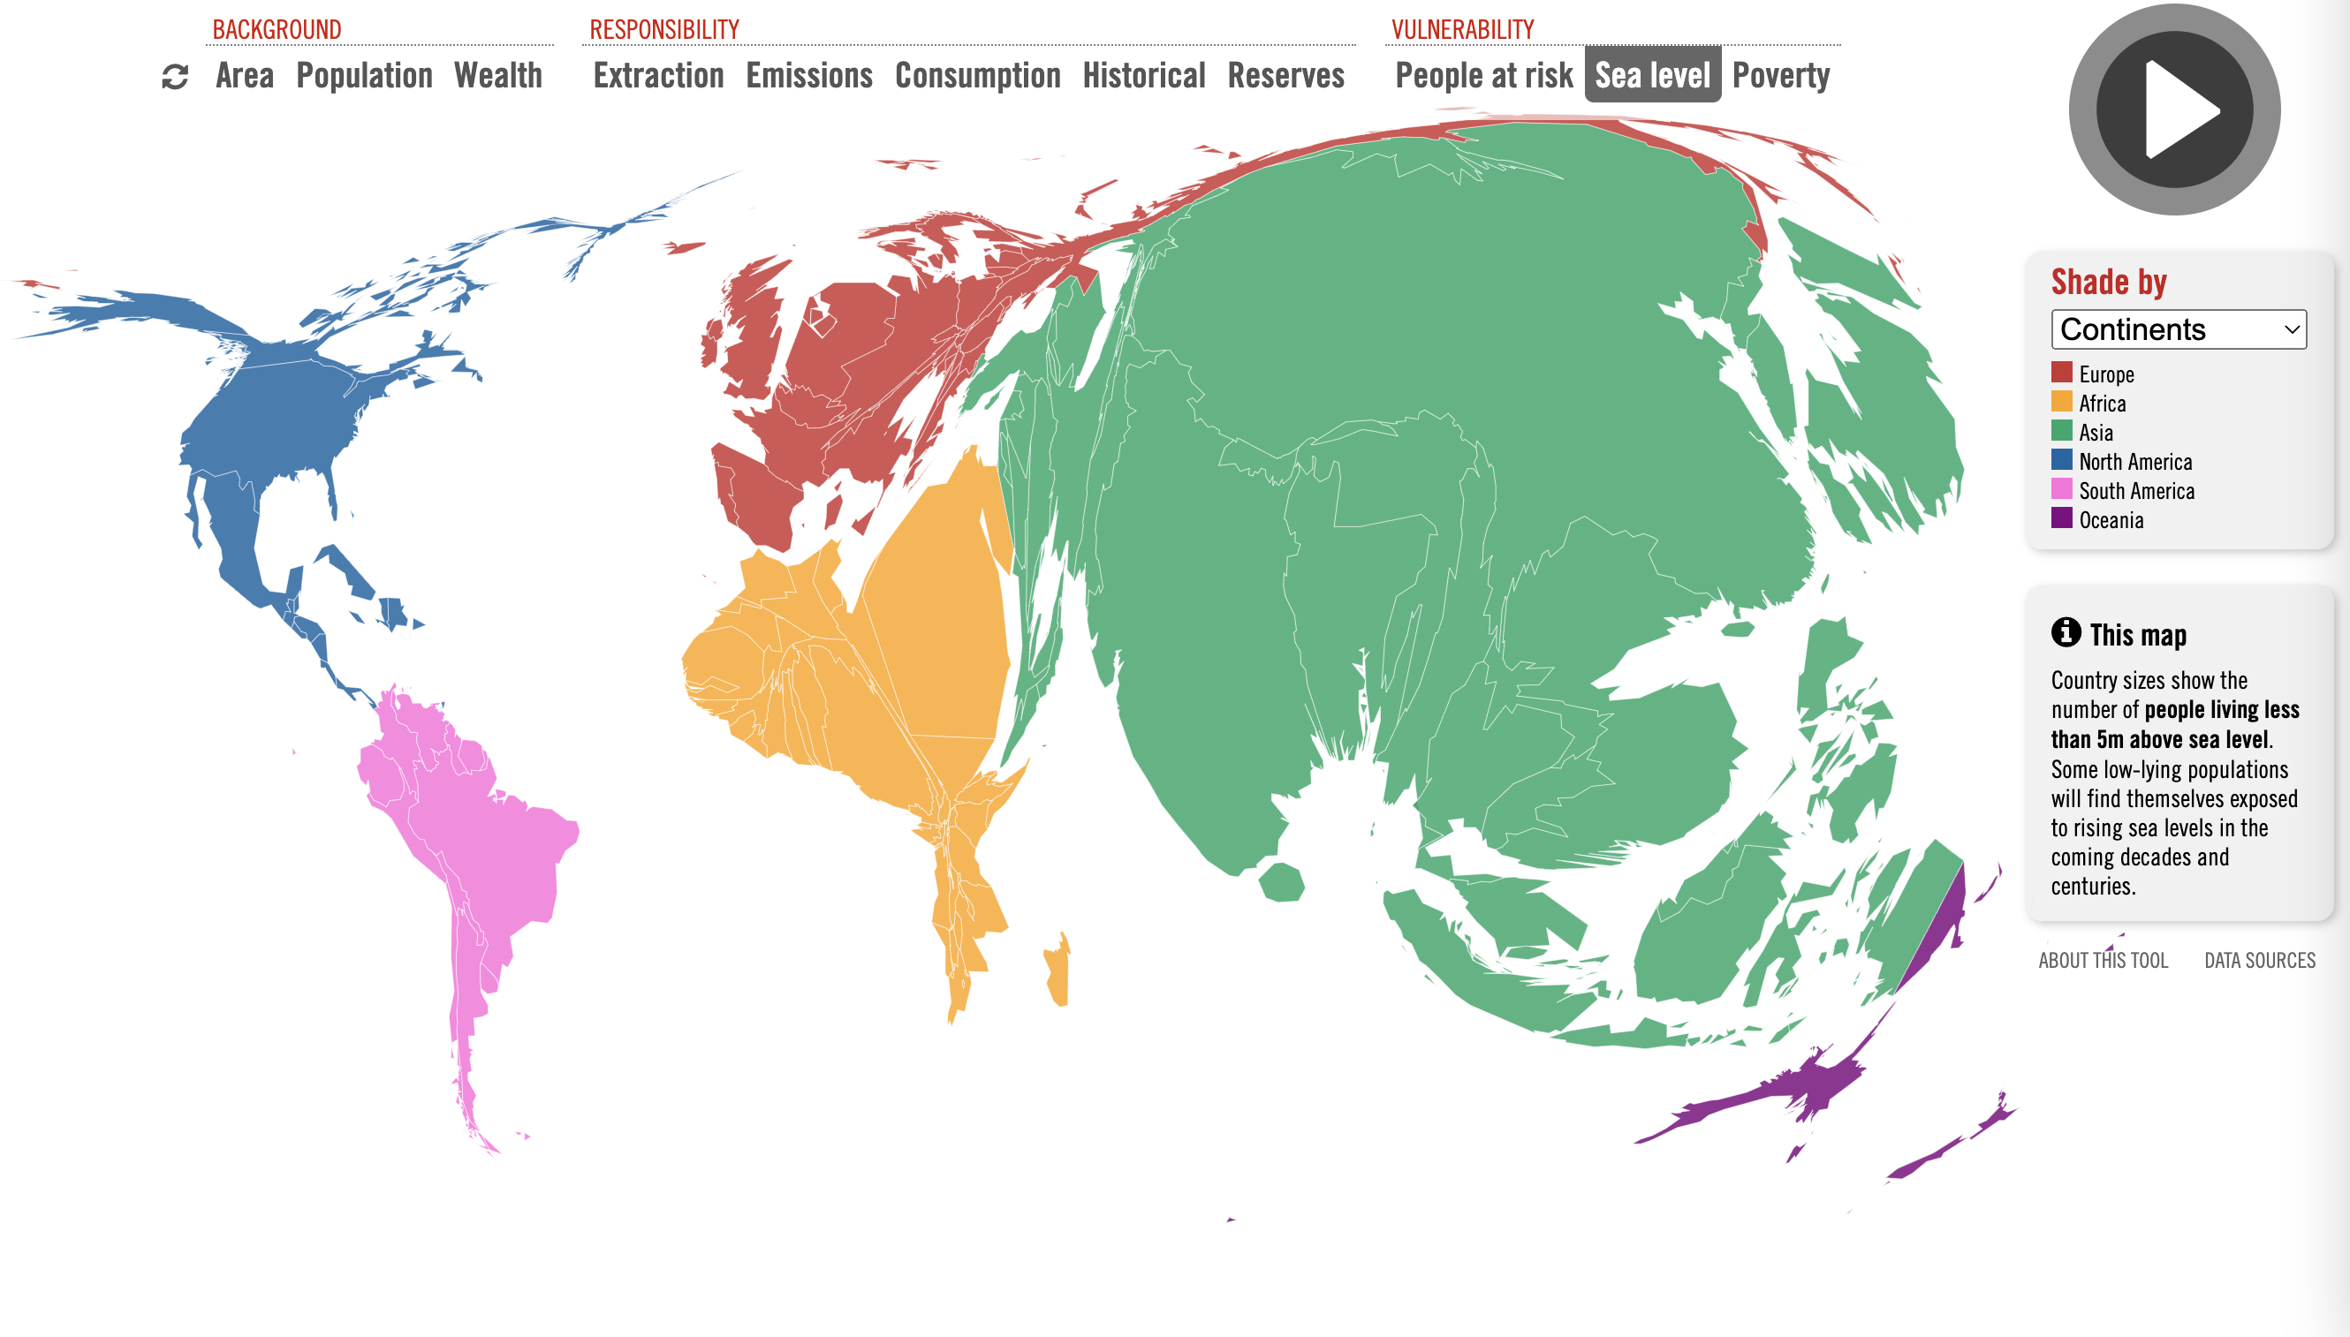
Country sizes show the number of people living less than 5m above sea level. Some low-lying populations will find themselves exposed to rising sea levels in the coming decades and centuries.

Slide 7

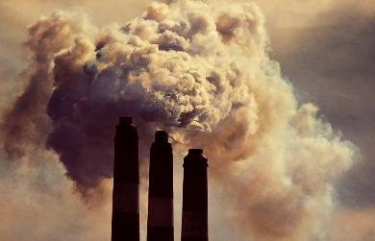
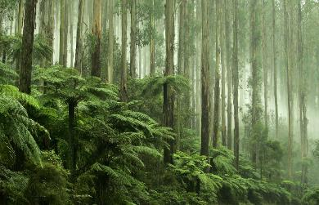
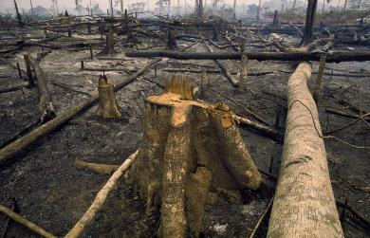
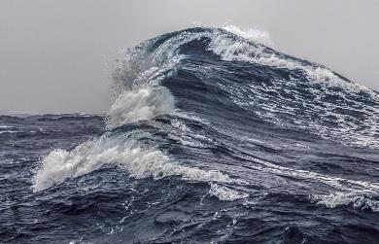
Where is the CO₂ ?
Sources = Sinks
编辑母版文本样式
  第二级
    第三级
      第四级
        第五级
18.6 GtCO₂/yr
48%
34.8 GtCO₂/yr
89%
29%
11.2 GtCO₂/yr
11%
4.1 GtCO₂/yr
26%
10.2 GtCO₂/yr
Budget Imbalance:
(the difference between estimated sources & sinks)
3%
-1.0 GtCO₂/yr
(Data: 2011-2020)

Slide 8
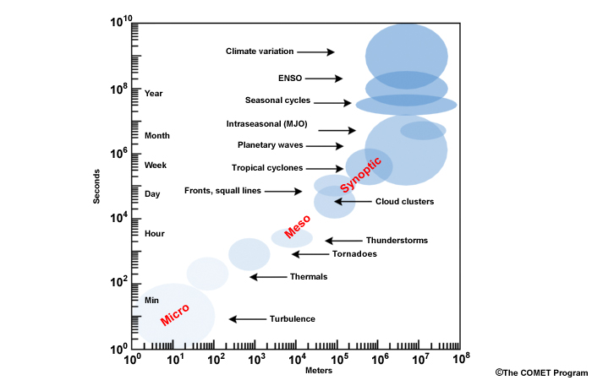
Spatio-Temporal Scales
Dissipative Systems (as atmosphere & ocean) cannot maintain large gradients on long time scales
Millenia
π * 10¹⁰
Ice ages
s
AMO
Decadal
s
Quasi-decadal
π * 10⁸
π * 10⁷
s
Spatial || temporal Scales
4 *10⁷
Global

Slide 9
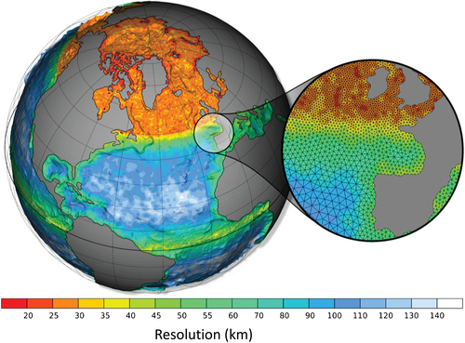
Earth System Analysis: Models
Notes:
One of the specific characteristics of Topic 3 is furthermore the modelling expertise, Proxy lab, and synthesis

Slide 10
Attribution (model world)
greenhouse gas emissions
observed changes are consistent with modeled response to external forcing, inconsistent with alternative explanations
no greenhouse gas emissions
Nobel Price, 2021
Notes:
evaluated whether observed changes are quantitatively consistent with the expected response to external forcings and inconsistent with alternative physically plausible explanations.
Could also make the point about needing to know the response to RF here.

Slide 11
Attribution (model world)
greenhouse gas emissions
observed changes are consistent with modeled response to external forcing, inconsistent with alternative explanations
no greenhouse gas emissions
Critics:
Time series too short
Estimates of natural variability based only on models
Notes:
evaluated whether observed changes are quantitatively consistent with the expected response to external forcings and inconsistent with alternative physically plausible explanations.
Could also make the point about needing to know the response to RF here.

Slide 12
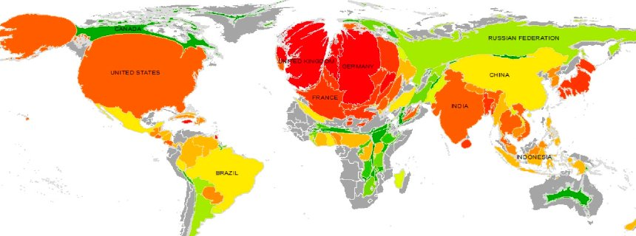
Contribution for global warming in the last 200 years

Slide 13
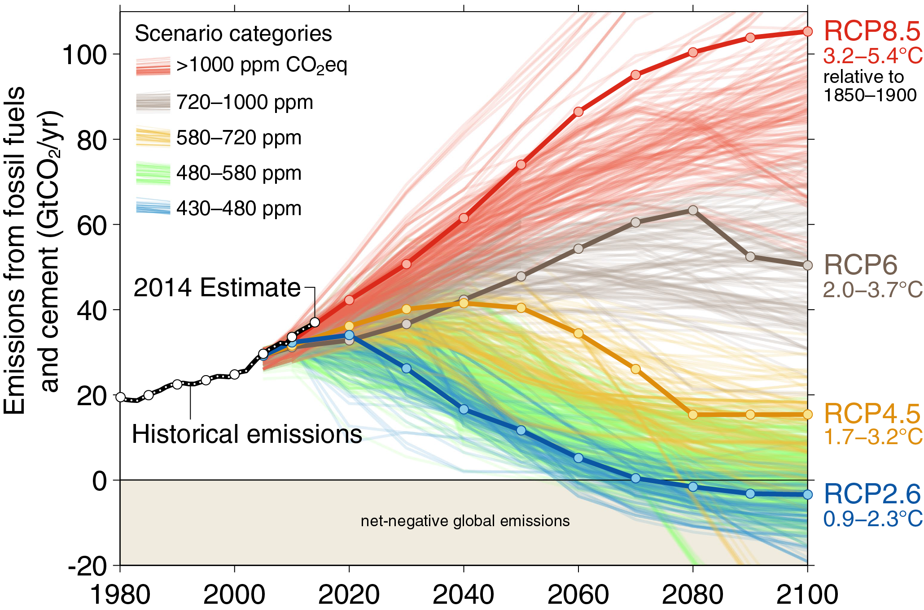
Business-as-usual
No Paris
Paris
World Meteorological Organization, 2014.

Slide 14
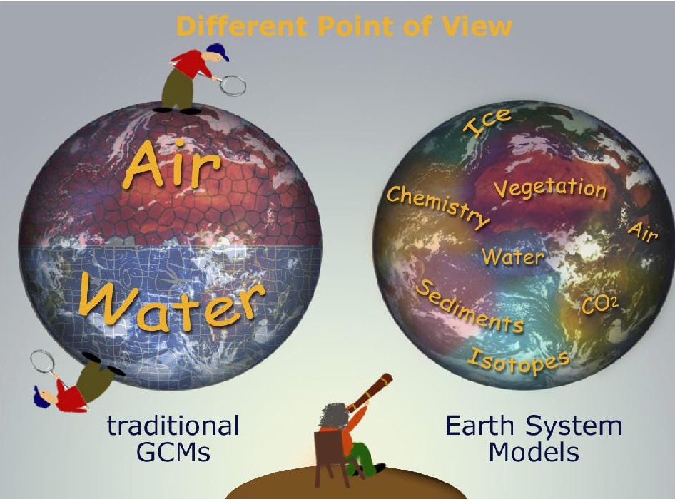

Slide 15
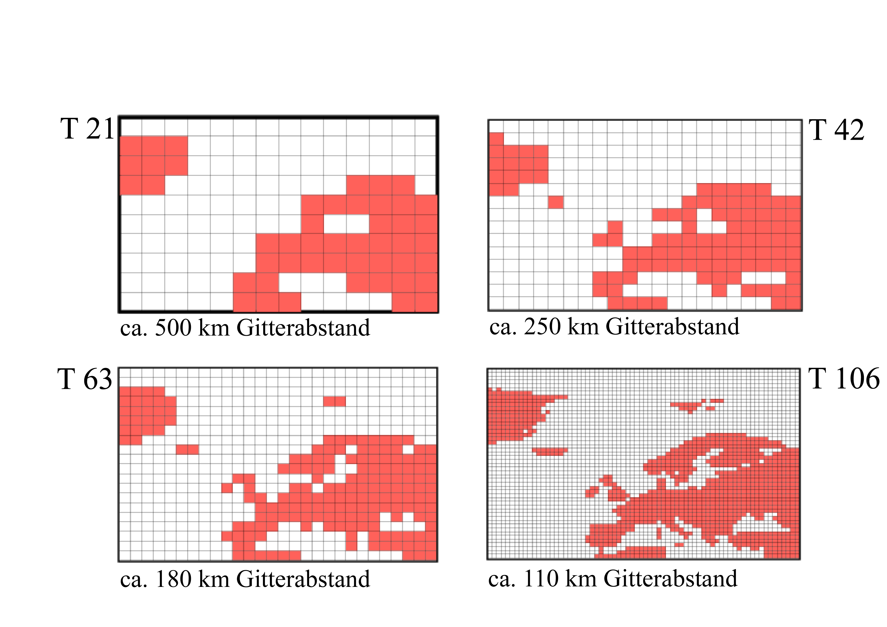

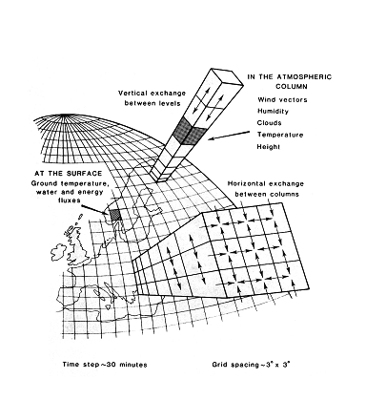
Examples of Resolution
(global spectral model, zoom onto Europe)
Skandinavien
Westeuropa

Slide 16
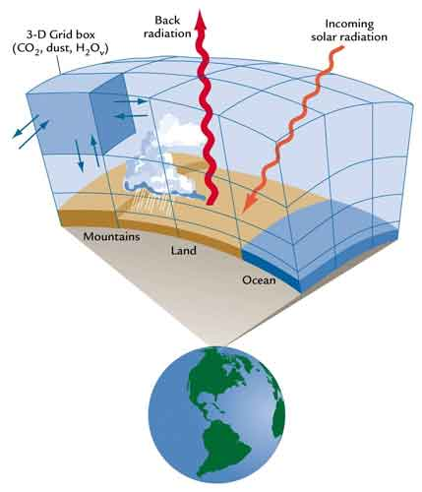
Atmosphere
Model

Slide 17
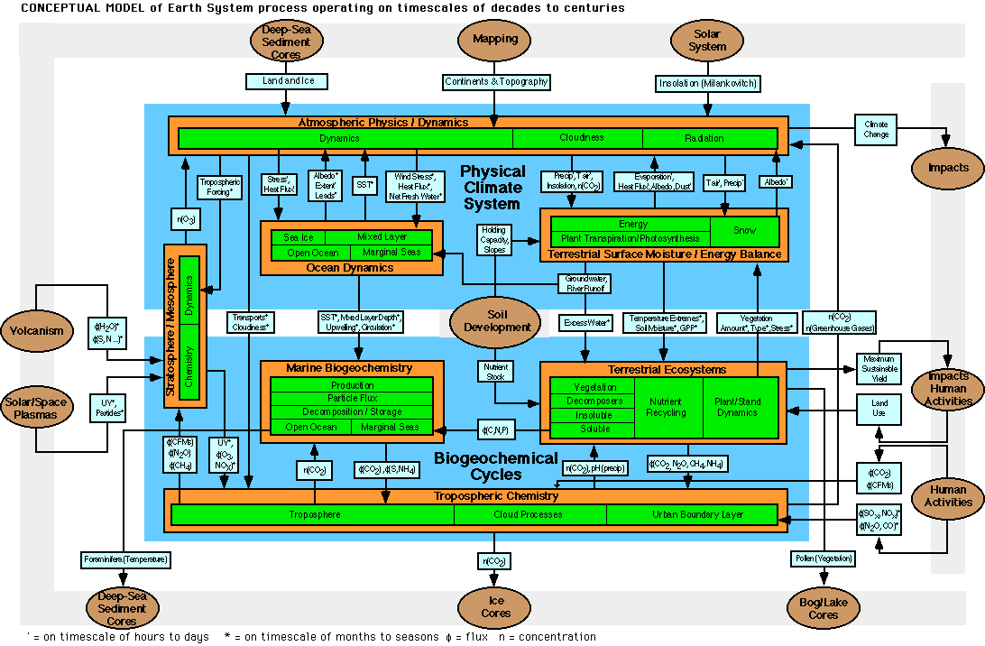
Coupling of ESM components
Bretherton

Slide 18
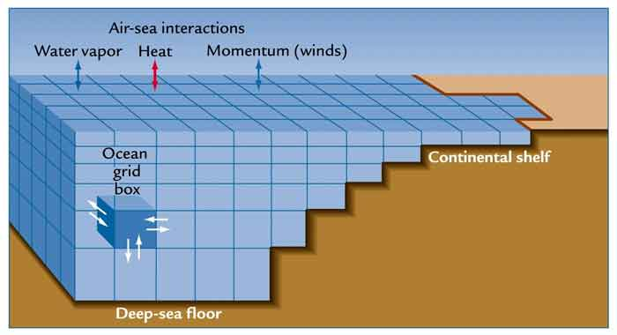
Coupling Atmosphere-Ocean
Water: Precipitation – Evaporation + Runoff
Heat: sensible+latent+radiation
Momentum: wind stress
Tracers: CO₂, C-14 etc.

Slide 19
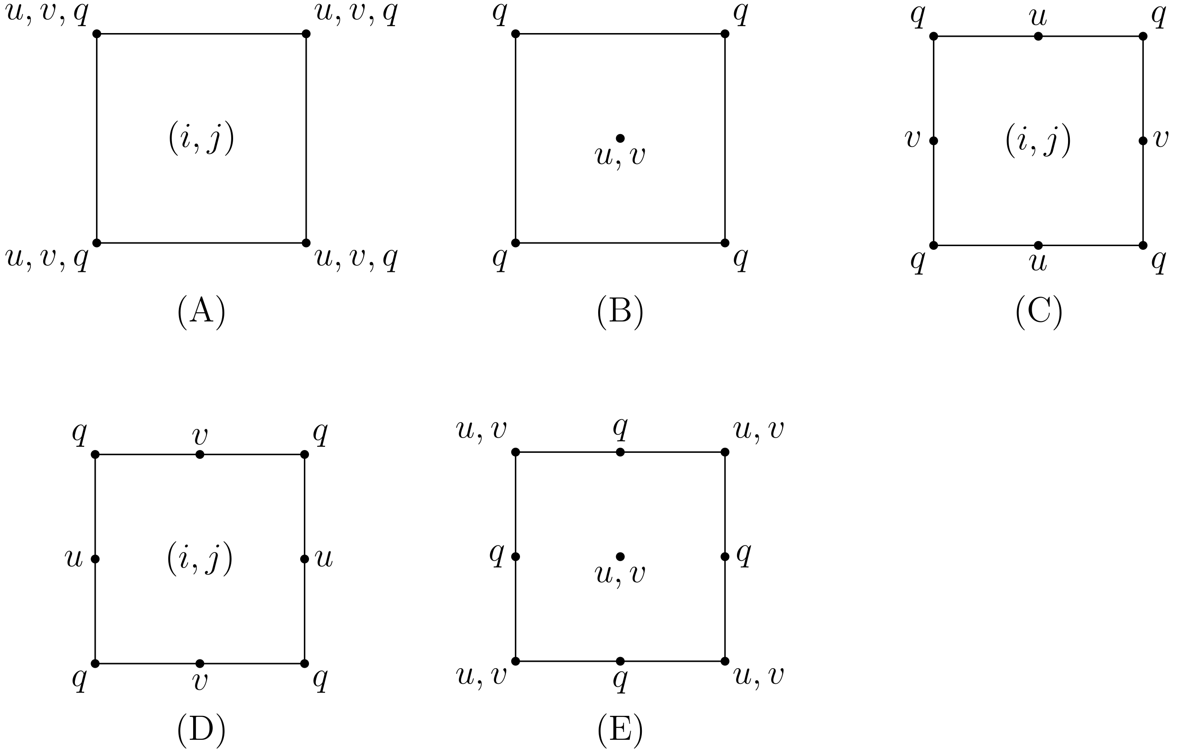
2D Staggered grids: Arakawa
unstaggered grid
Advection of tracers
C Grid
Rotated C
Arakawa and Lamb (1977) doi:10.1016/B978-0-12-460817-7.50009-4

Slide 20
Ocean circulation models tracers in the sea
time tracer: C-14

Slide 21
CO₂
Time scale?

Slide 22
C reservoirs + perturbation

Slide 23
tracer: C-14
Concentration relative to atmosphere
Percentage of total carbon content

Slide 24
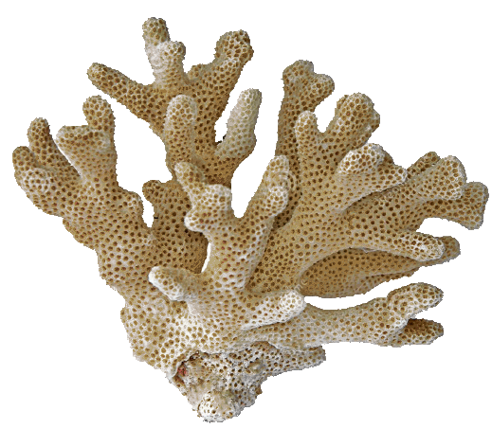
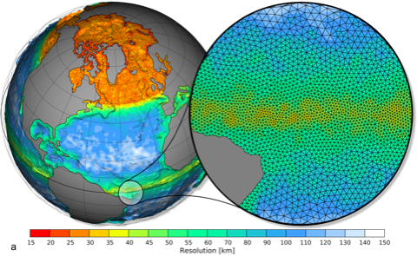
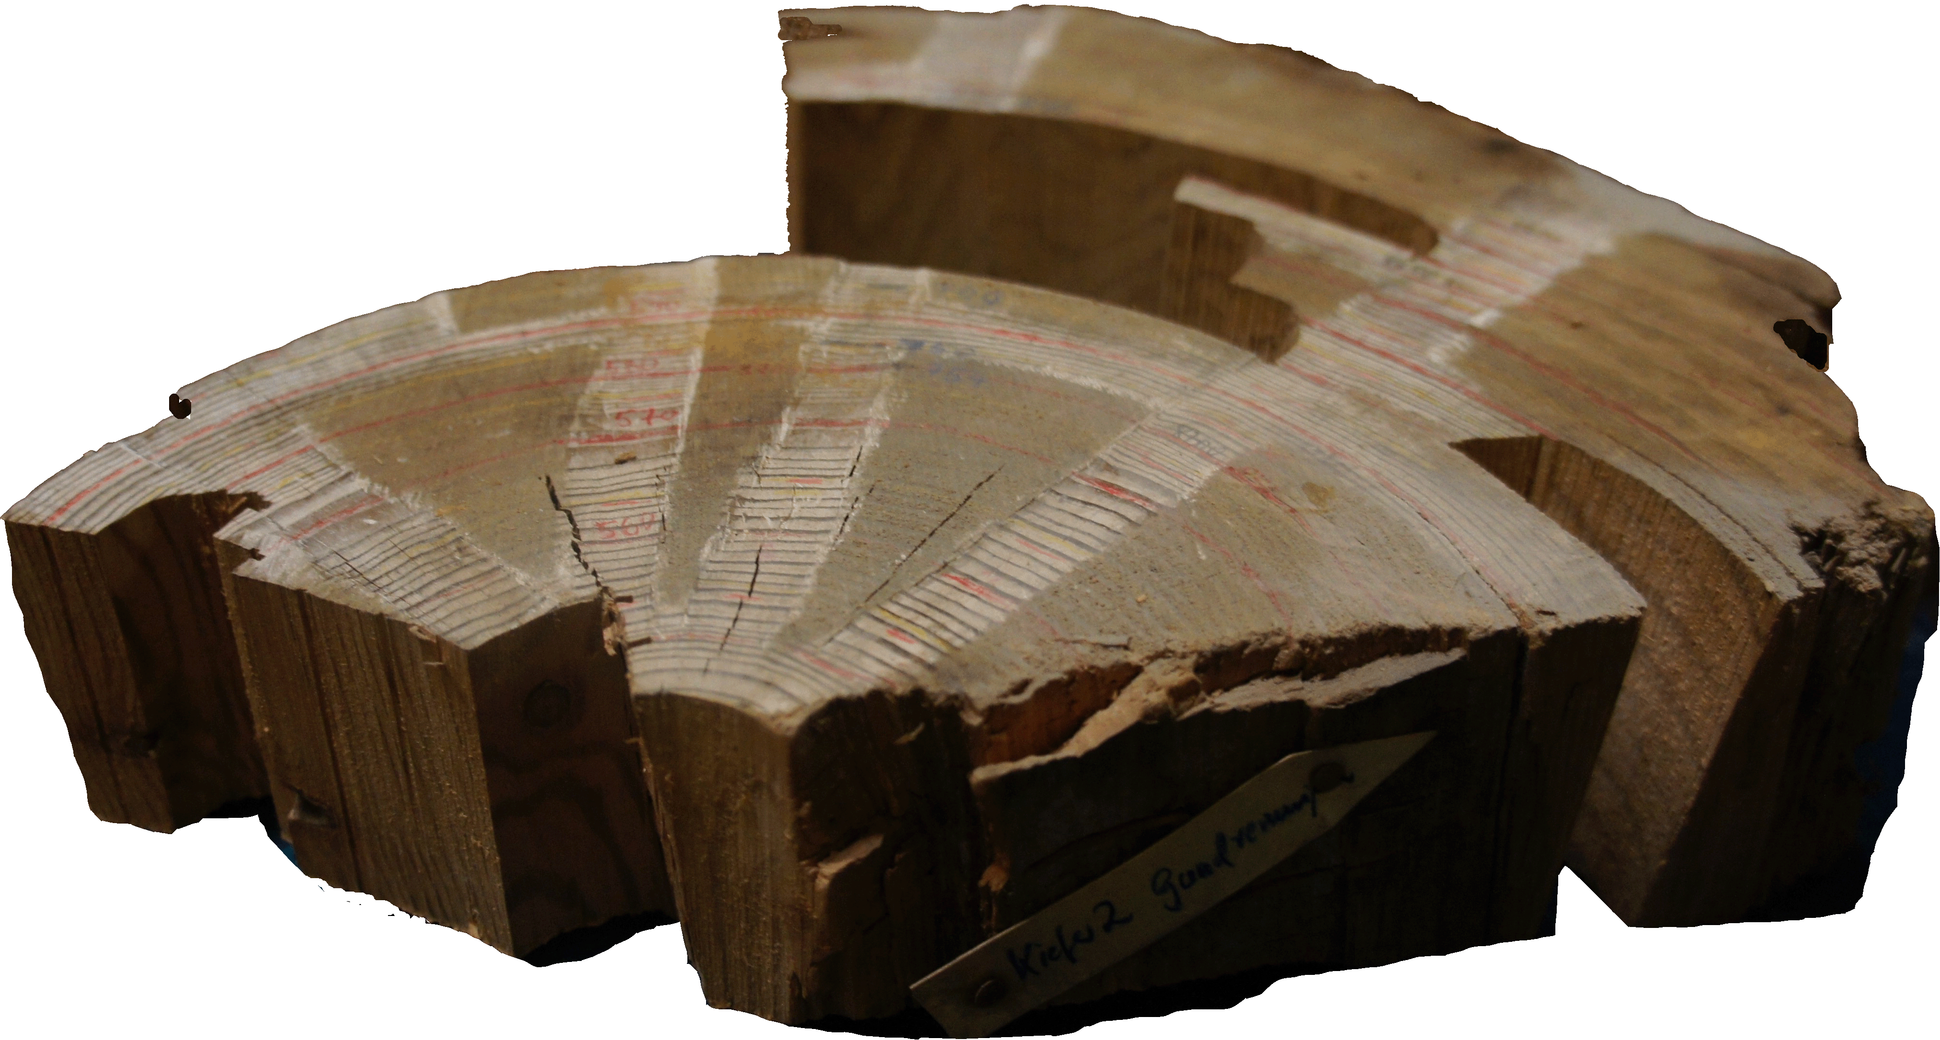
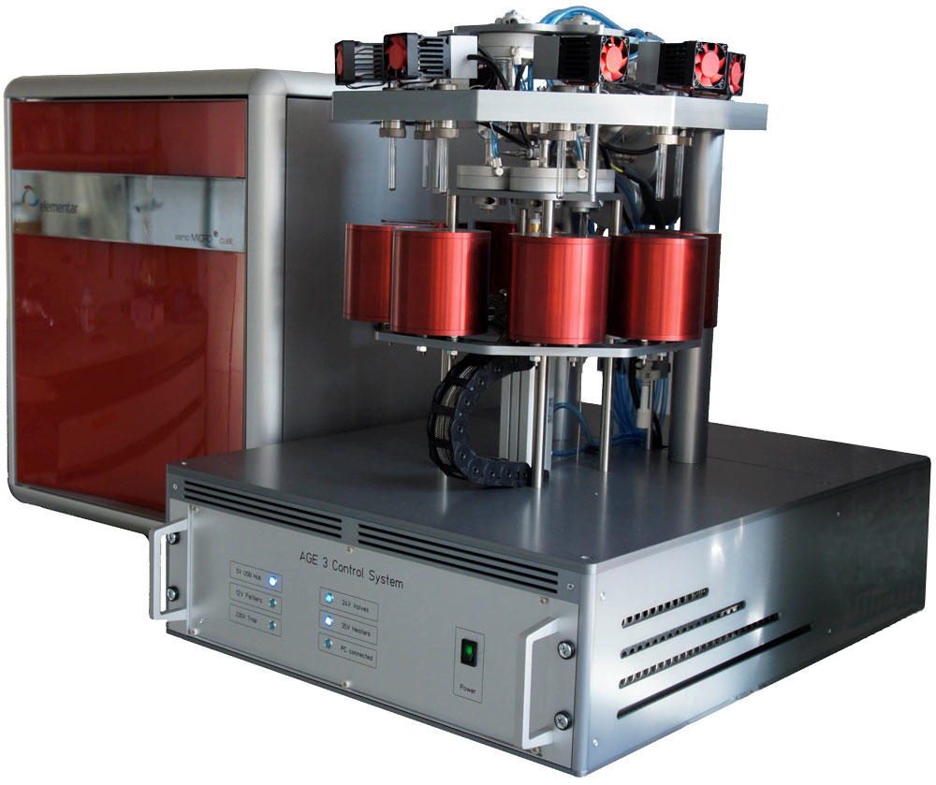
Radiocarbon tracer
ESM simulations of C-14
High-precision measurements
Lohmann et al., 2020

Slide 25
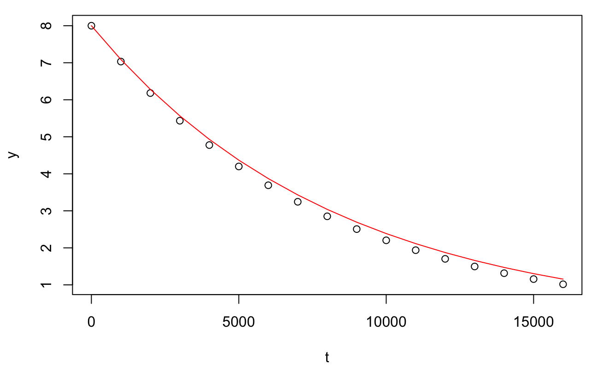
Exercise Radioactive decay
¹⁴C(t)=¹⁴C(t₀)⋅exp[−k(t−t₀)]
Radiocarbon as dating tool
Many decay processes that are often treated as exponential, are really only exponential so long as the sample is large and the law of large numbers holds.
For small samples, a more general analysis is necessary, accounting for a Poisson process.

Slide 26
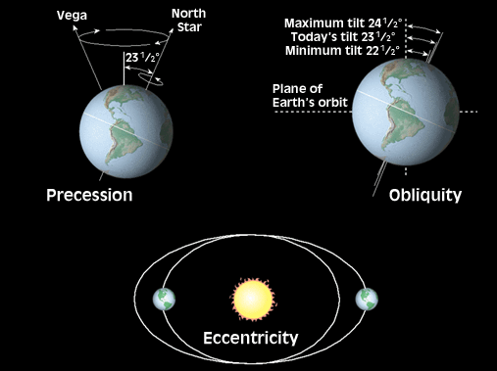
schematic
climate variability spectrum
4
spatial scale
global
Ice ages
Holocene
trends
hemispheric
AMO
DO,
H-events
Season
Quasi-
decadal
regional
ENSO
1000 km
Internal variability
Synoptic
variations
100 km
Turbulence, mixing etc.
m
internal variability
millennia
centennial
decadal
annual
days
seconds
Long time scale
Short time scale

Slide 27
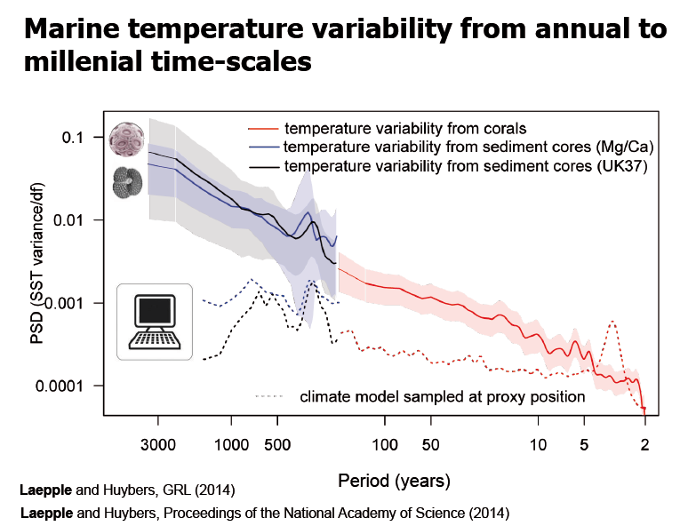
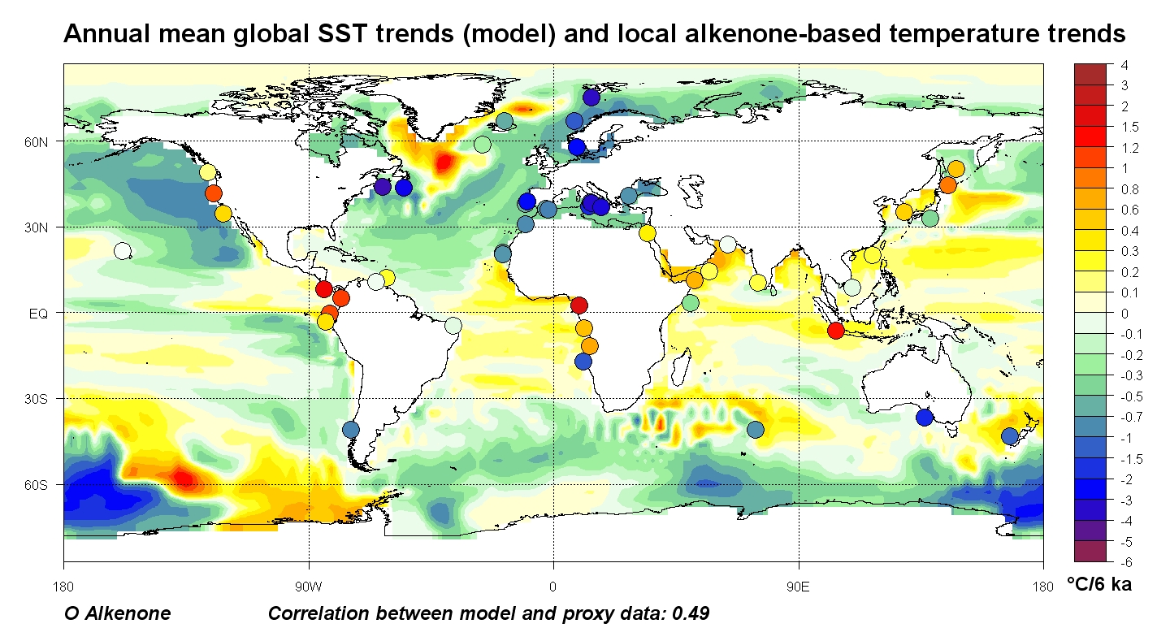
Marine temperature trends of the last 6000 years
Annual mean sea surface temperature trends
Alkenone-based temperature trends
Lohmann et al., 2013
Notes:
Plot the reconstructed

Slide 28
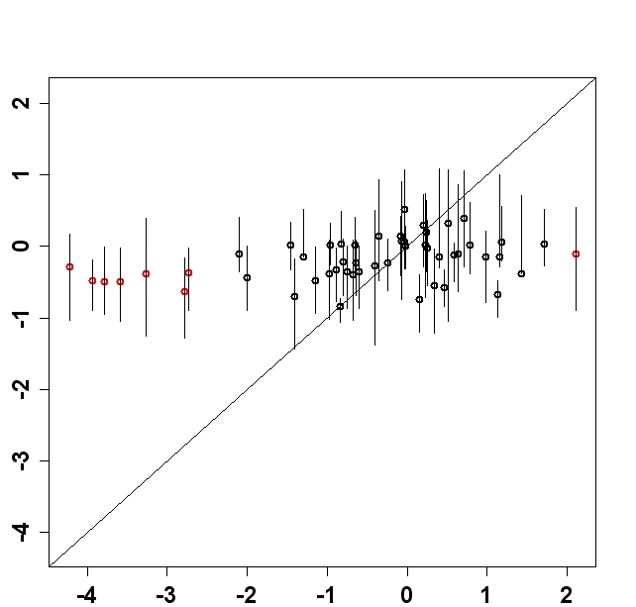
Marine temperature trends of the last 6000 years
Annual mean sea surface temperature trends
Response too low
Alkenone-based temperature trends
Lohmann et al., 2013
Notes:
Plot the reconstructed

Slide 29
Marine temperature variability
(annual to millennial time scales)
Power spectrum
Current climate models seem to underestimate long-term variability
Laepple and Huybers, 2014; GRL, PNAS
Notes:
Taking basically the same data, we analyzed the spectrum

Slide 30
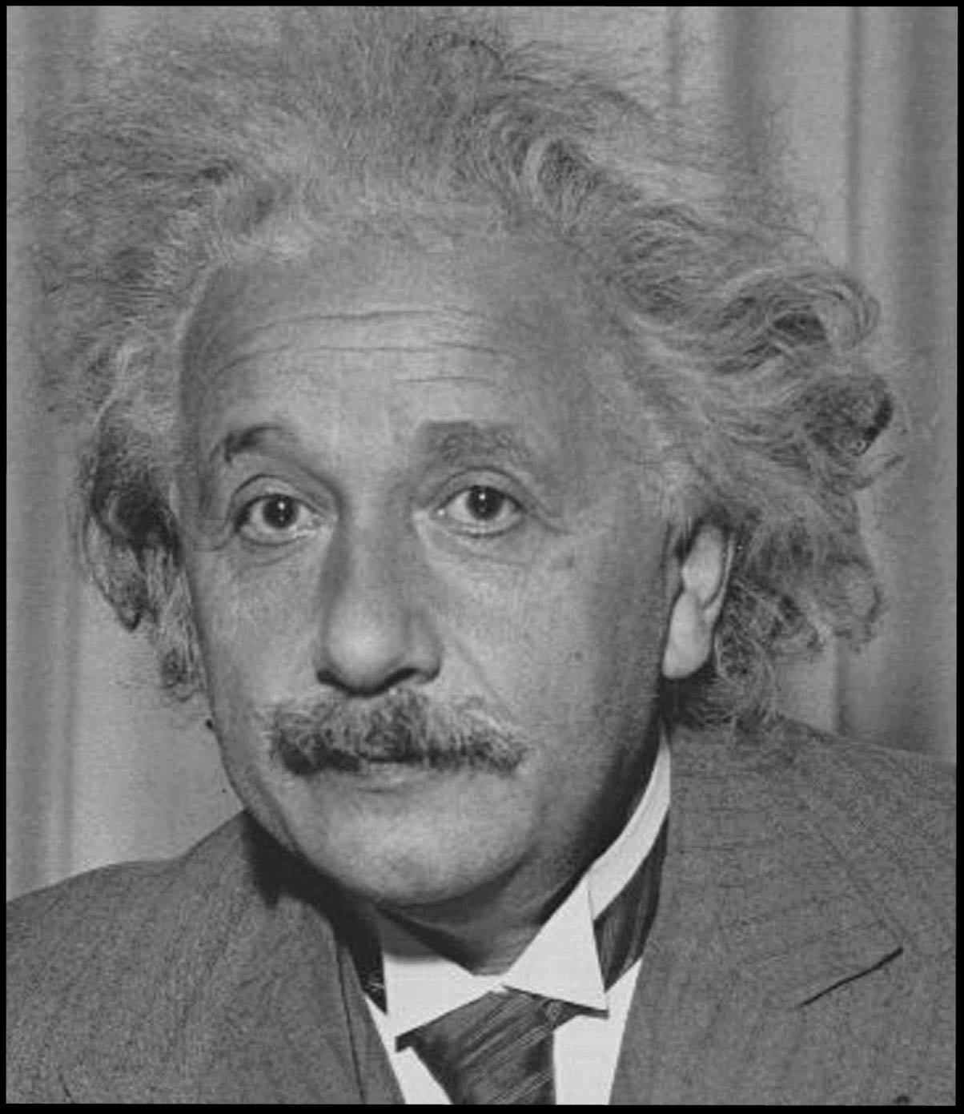
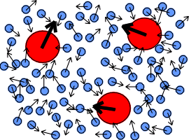
Brownian Motion
Einstein, Orstein, Uhlenbeck, Wiener, Fokker, Planck et al.
dx/dt = f(x) + g(x) dw/dt

Slide 31
Granular structure of nature
Brownian Motion: visible under the Mikroscope: Motion of particles
pulses, irregular
Living?
Pulses from all directions, random
Notes:
Die brownsche Bewegung ist die vom schottischen Botaniker Robert Brown im Jahr 1827 entdeckte unregelmäßige und ruckartige Wärmebewegung kleiner, aber mikroskopisch sichtbarer Teilchen in Flüssigkeiten und Gasen.

Slide 32
Brownian motion
is the random movement of particles, caused by their bombardment on all sides by bigger molecules.
This motion can be seen in the behavior of pollen grains placed in a glass of water
Because this motion often drives the interaction of time and spatial scales, it is important in several fields.

Slide 33
Physics of the 20th century
The matter the world is made of
views: Elementary particles, quantum mechanics, relativity theory
Limit of divisibility (Democritus, Aristotle): Matter is not a continuous whole: "The world cannot be composed of infinitely small particles".

Slide 34
Coarse graining -> Stochastic

Slide 35
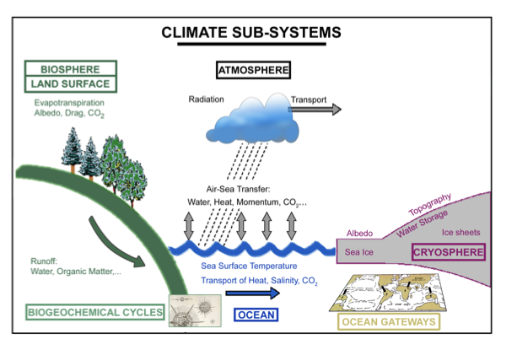
Climate variability
Brownian Particle: Climate
Molecules: Weather

Slide 36
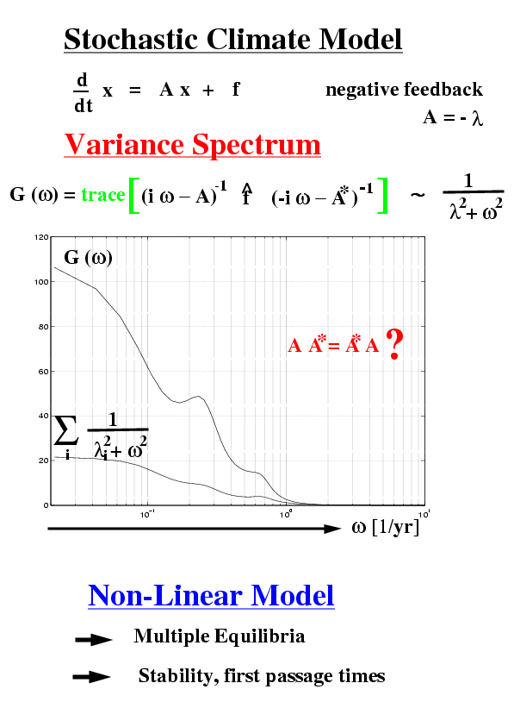
Following an idea of Hasselmann one can divide the climate dynamics into two parts. These two parts are the slowly changing climate part and rapidly changing weather part. The weather part can be modeled by a stochastic process such as white noise

Slide 37
Predictability

Slide 38
Climate variability and sensitivity are related
“two sides of the same coin”
Stochastic climate model
Noise
Forcing
Damping too high
Power spectrum
Equilibrium response
Response too low
Forcing
Variance too low
Lohmann, 2018
Notes:
The damping lambda is too high

Slide 39
Holocene SST -Trends 6000 years: Ocean model resolution
PMIP2, ~3° resol
PMIP3, ~2° resol
Climate model
ECHAM6-FESOM
Downscaling Ocean
AWI-CM
Notes:
2nd example: again the Holocene trends

Slide 40
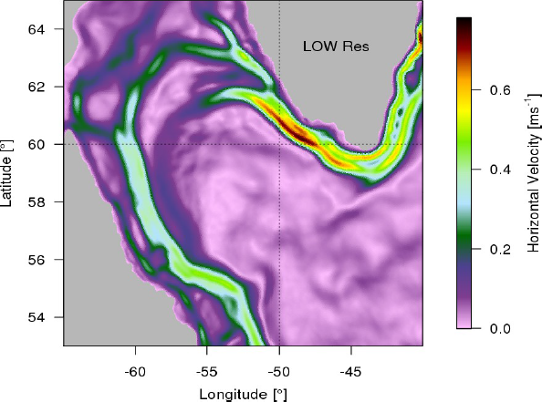
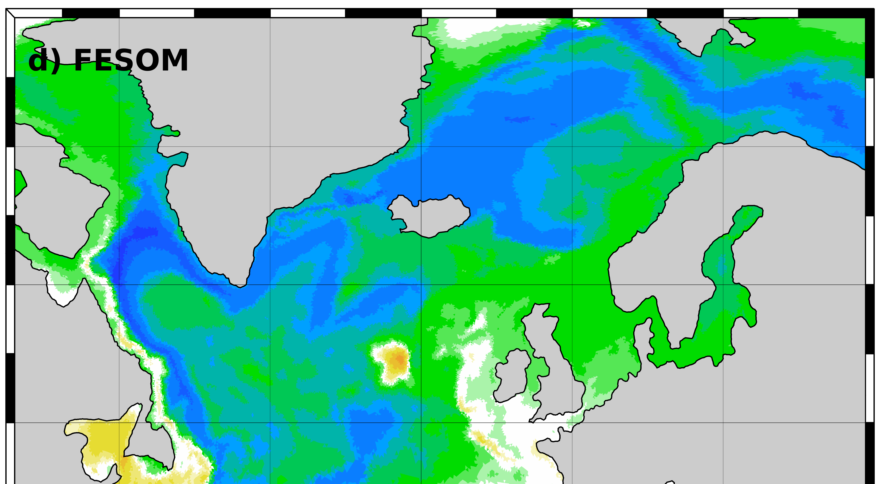
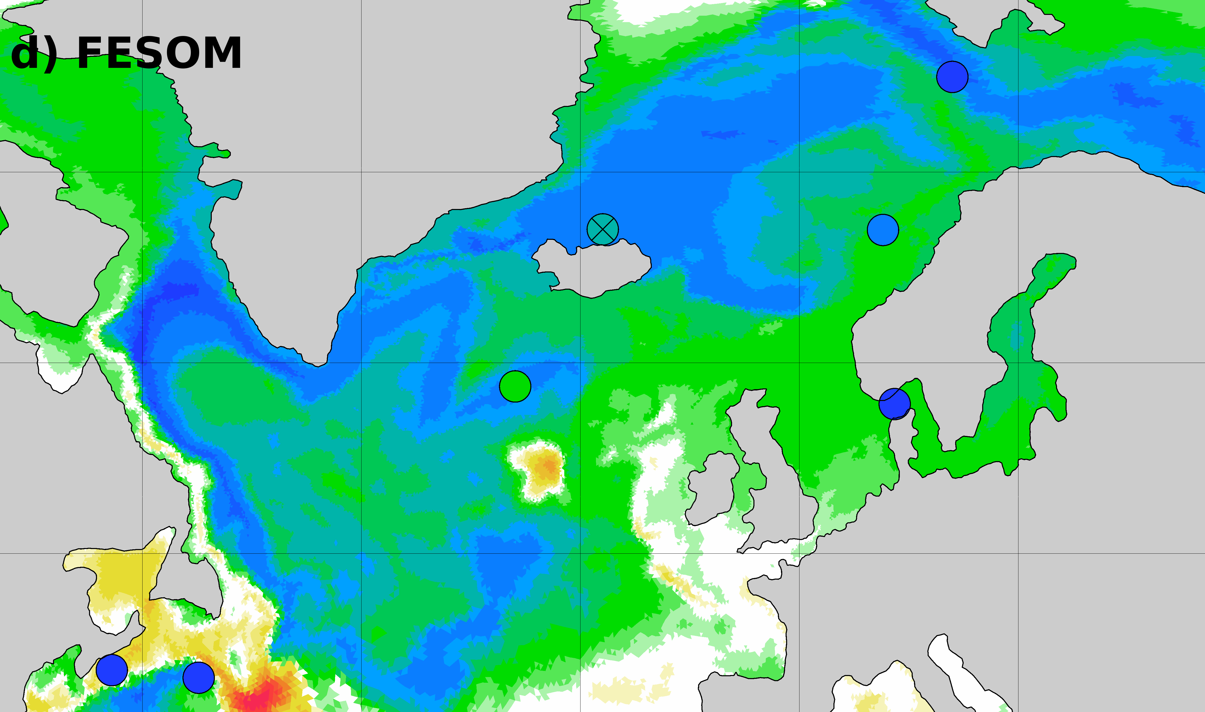
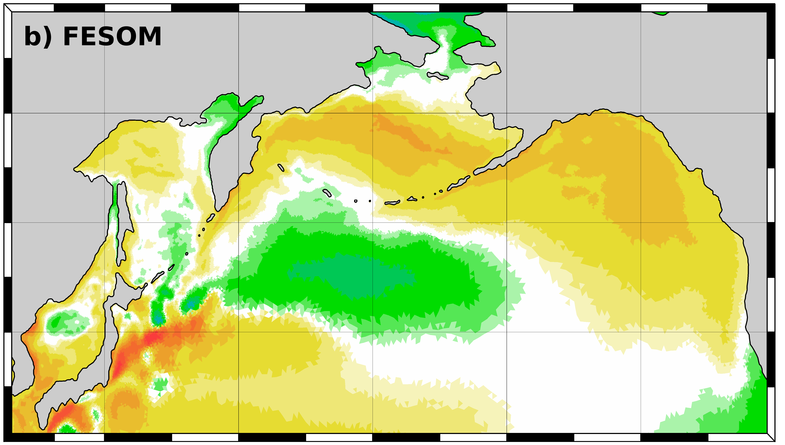
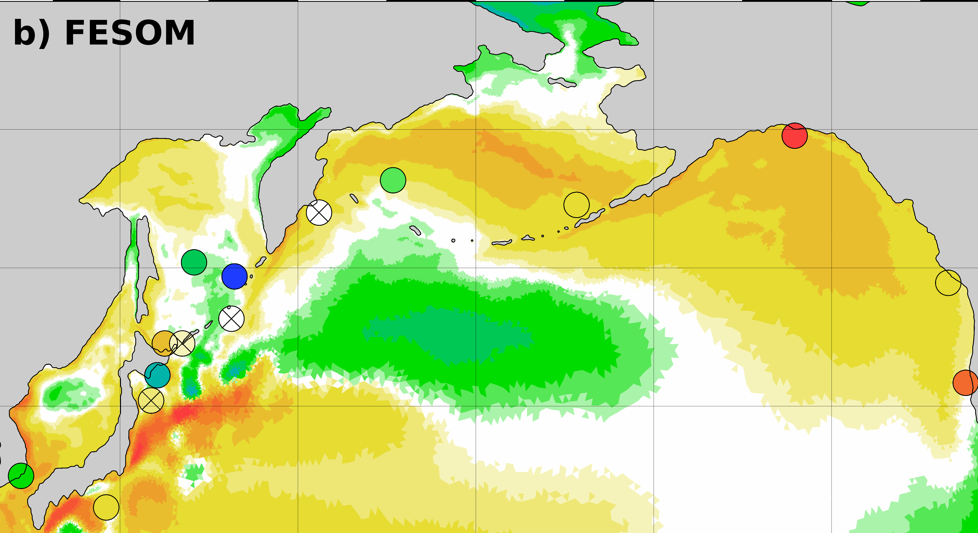
Holocene SST -Trends 6000 years: Ocean model resolution
Heterogenous trends
Long time scales
PMIP2, ~3° resol
PMIP3, ~2° resol
Climate model
ECHAM6-FESOM
Downscaling Ocean
AWI-CM
Neues Modell FESOM
Persistenz von Jets, westlichen Randströmen
Neues Modell FESOM
Persistenz von Jets, westlichen Randströmen
Notes:
Zooming into the North Atlantic/Pacific showing the heterogeneity in the model (as in the data)

Slide 41
Earth system models tracers and dynamical vegetation

Slide 42
Land and vegetation
Sea Ice

Slide 43
The Carbon Cycle
Carbon is the key element for living things.
Carbon in the atmosphere and dissolved in the oceans as part of the inorganic CO₂
CO₂ is recycled into more complex organic substances through photosynthesis.

Slide 44
Photosynthesis – process by which green plants make their own food from water, carbon dioxide, and light energy, producing sugar (stored energy) and oxygen (a by-product).
The general equation for photosynthesis is:
6CO₂ + 6H₂0 → C₆H₁₂O₆ + 6O₂
Energy
Carbon dioxide
Water
Oxygen
Carbohydrates

Slide 45
Vegetation & Ecosystem

Slide 46
Human Impact
Deforestation – cutting down forests has reduced the amount of plants available for photosynthesis, which means that less CO₂ can be removed from the atmosphere.
Burning (combustion) of fossil fuels – gasoline, coal, and natural gas contain carbon and when burned, they release CO₂ into the Earth’s lower atmosphere. There is concern that the increase in CO₂ will lead to global warming.

Slide 47
Population Growth (ideal conditions)
The larger the population gets, the faster the population grows.
Population
  Population will increase rapidly in size
  The larger a population gets, the faster it increases
Population is growing slowly
Time

Slide 48
Population
Population rate decreases
The larger the population gets, the less resources there are. The population cannot increase anymore.
Population rate increases
Time

Slide 49
https://web.nateko.lu.se/lpj-guess/education/

Slide 50
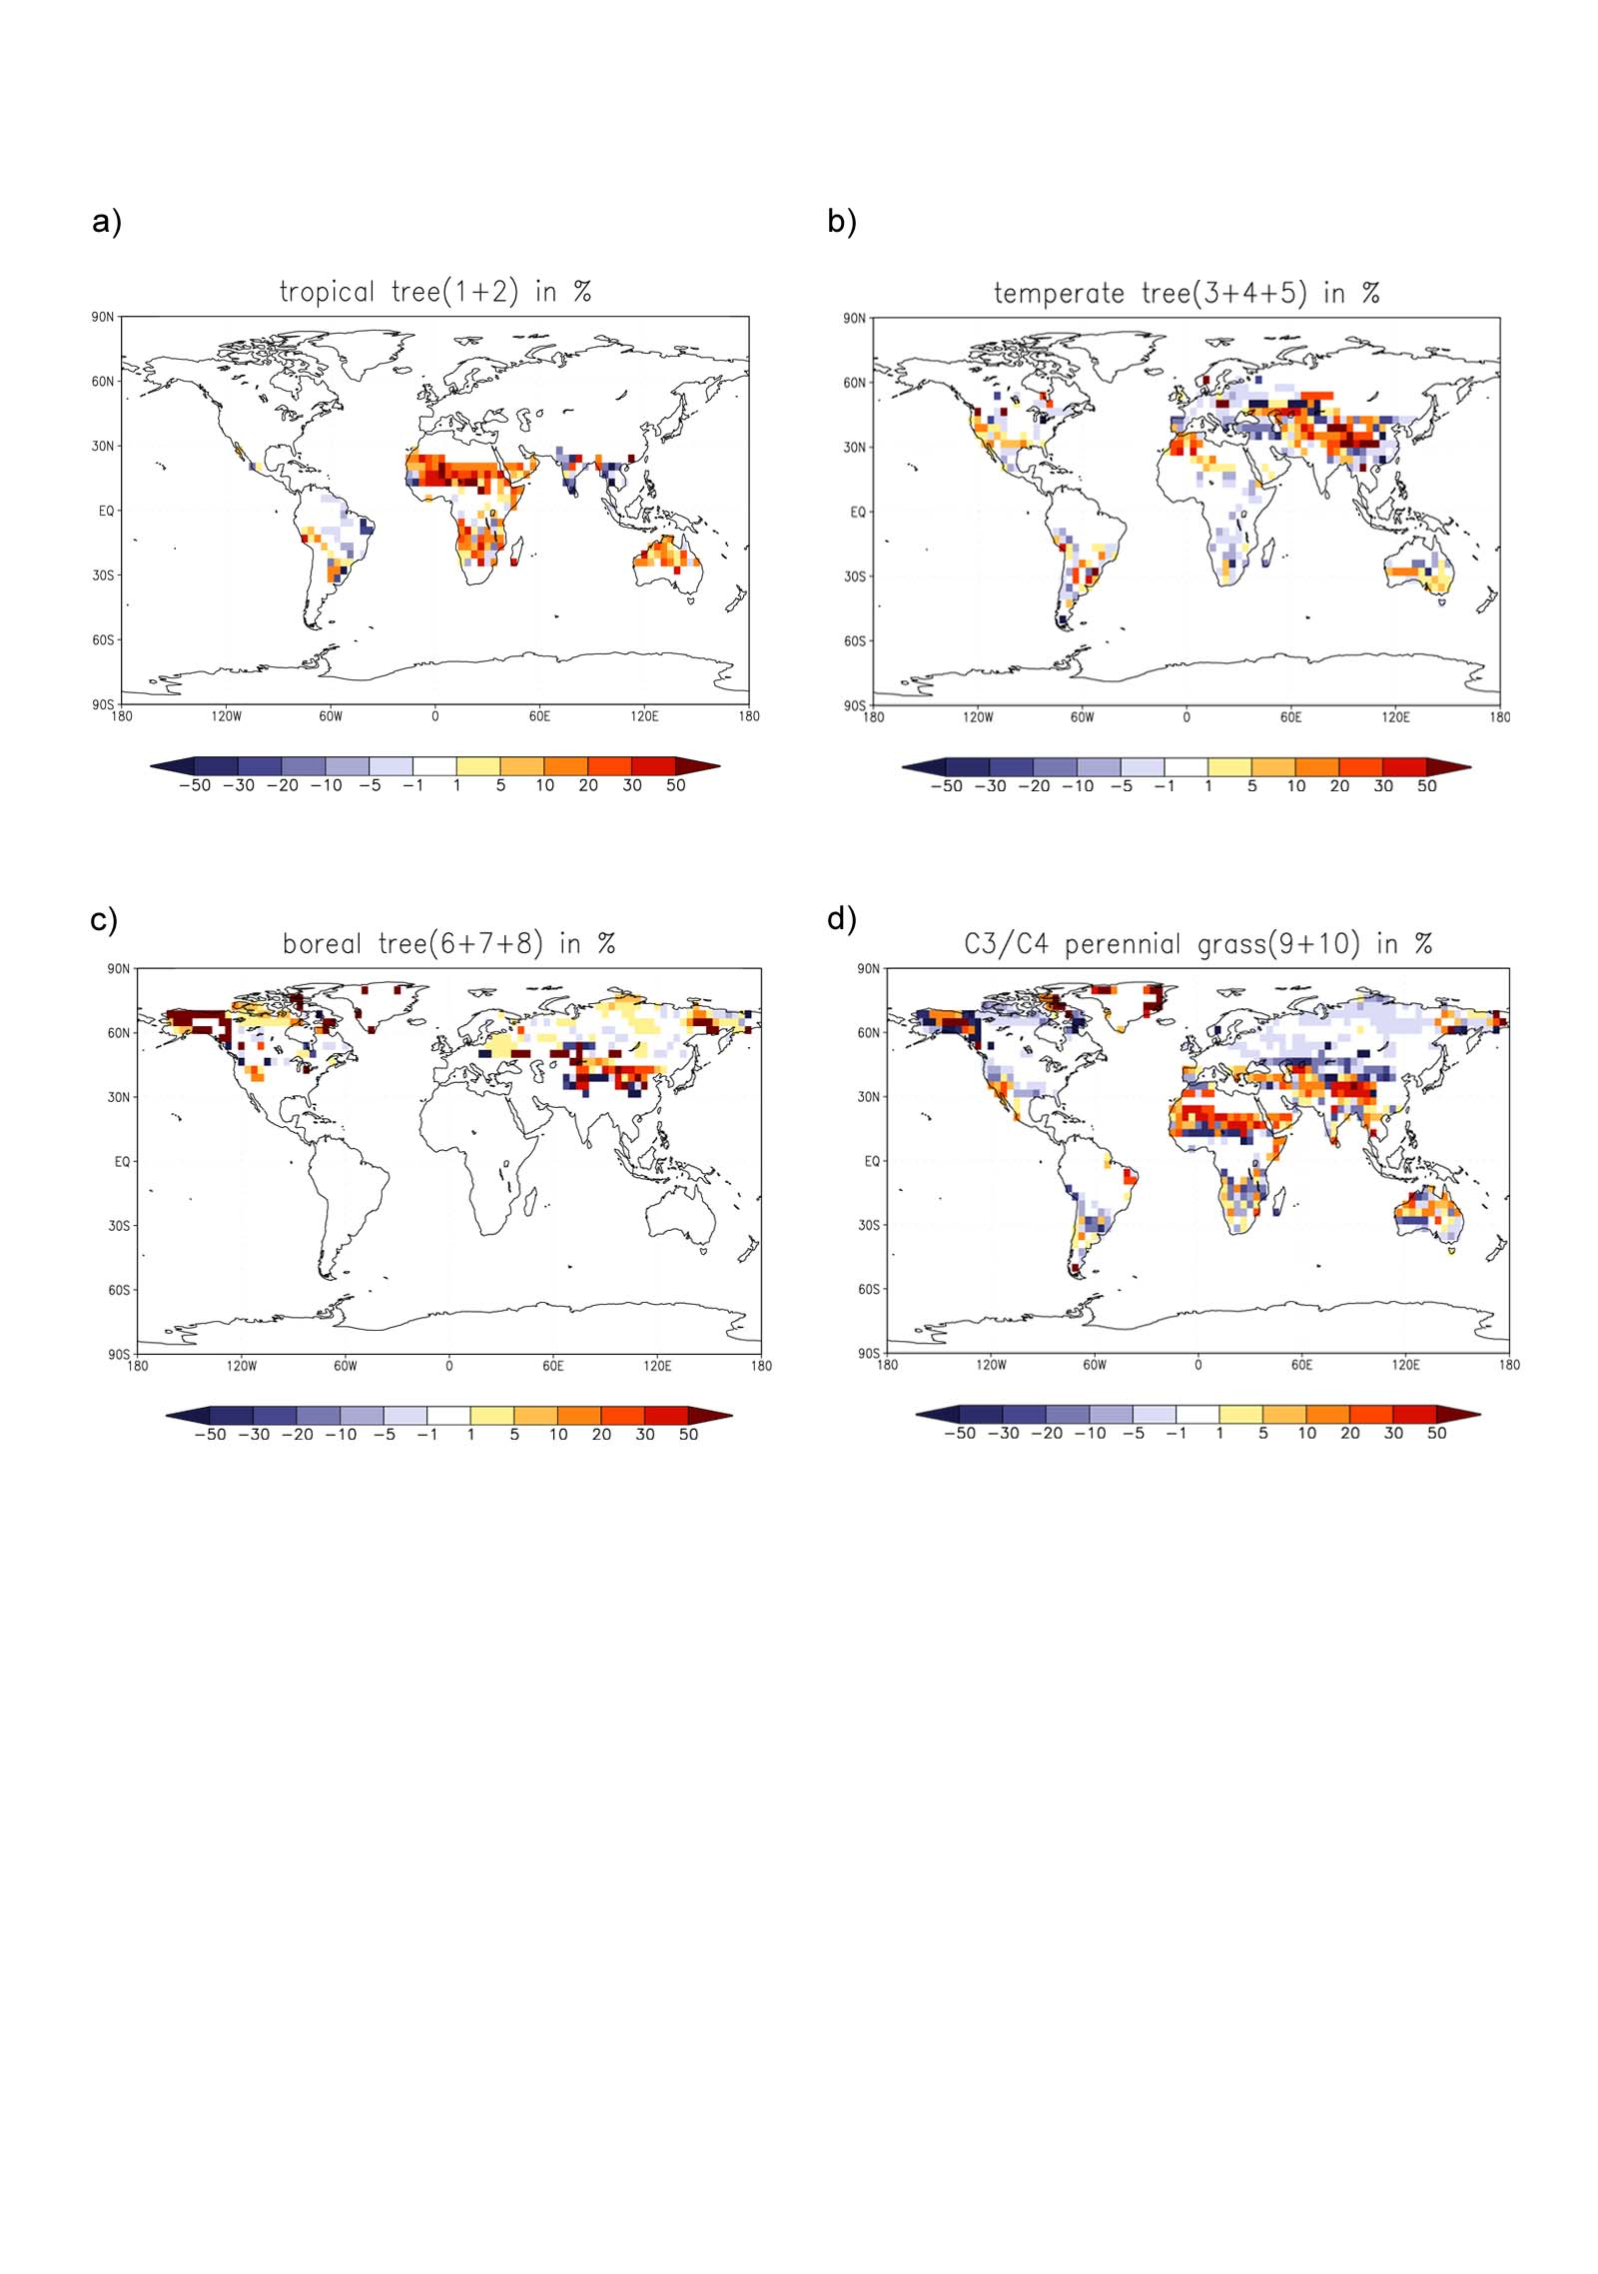
Typical output of a vegetation model

Slide 51
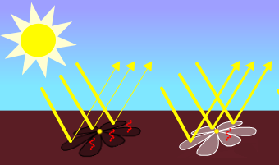
Daisy World & the Gaia Hypothesis
Sunlight reflects off different color daisies.
Black daisies absorb most light, turning it into heat.
White daisies reflect most light, and stay cooler.

Slide 52
Daisy World & the Gaia Hypothesis
Sunlight reflects off different color daisies.
Black daisies absorb most light, turning it into heat.
White daisies reflect most light, and stay cooler.
By the mix of white and black daisies and barren ground, Daisy World strives to keep its temperatures in the range that allows daisies to live.

Slide 53
Daisy World & the Gaia Hypothesis
Sunlight reflects off different color daisies.
Black daisies absorb most light, turning it into heat.
White daisies reflect most light, and stay cooler.
By the mix of white and black daisies and barren ground, Daisy World strives to keep its temperatures in the range that allows daisies to live.
When the world is too cool for black daisies to warm it, or too hot for white daisies to cool it, the planet is barren.

Slide 54
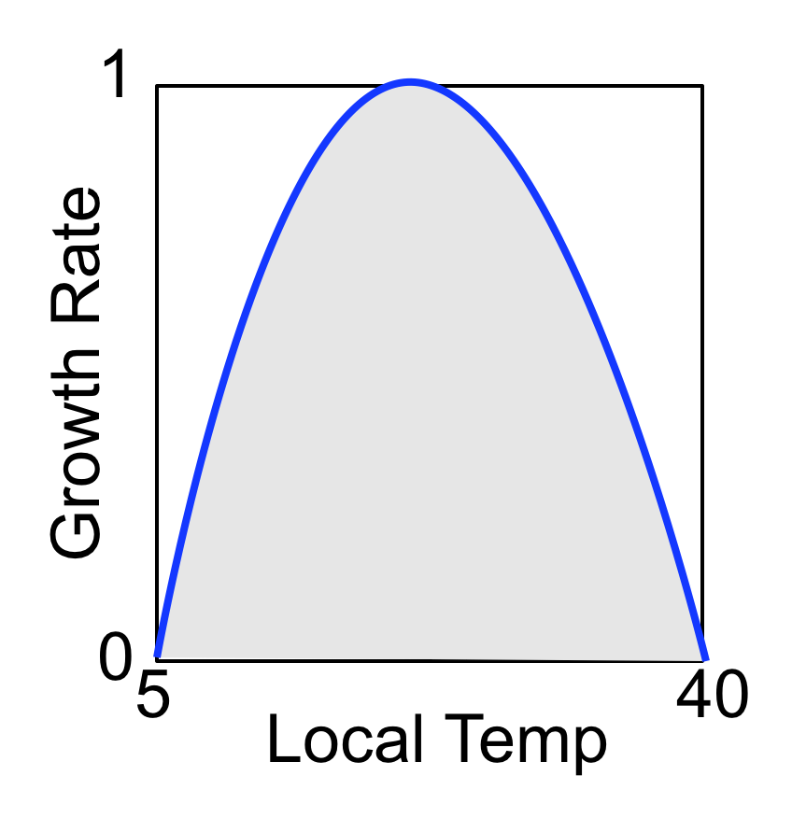
Vegetation Model
Evolution of area fractions of white (a_{w}) and black (a_{b}) daisies
Growth rate is temperature dependent

Slide 55
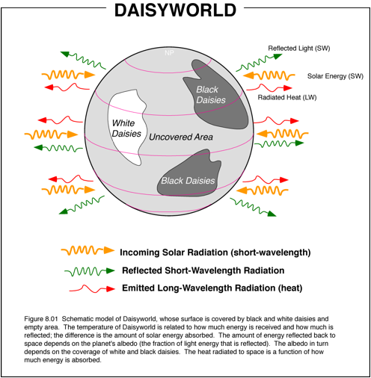
Vegetation Model
Evolution of area fractions of white (a_{w}) and black (a_{b}) daisies
Growth rate is temperature dependent

Slide 56
Vegetation Model
Evolution of area fractions of white (a_{w}) and black (a_{b}) daisies
Growth rate is temperature dependent
Planetary albedo
Gobal temperature
L: luminosity
Climate Model
q=2.06×10⁹ K⁴ is a heat transfert coefficient

Slide 57
Exercise daisy
https://paleodyn.uni-bremen.de/study/MES/daisy/
1) Run Daisy World with the 2 Daisies - black and white. Notice for what range of luminosity the daisies manage to control the planet temperature.
2) Do you think control would be better if you set the low and high albedos (for black and white) to a wider spread?
3) You will notice that the living area (“total daisies”) doesn’t exceed 70%. The deathrate is set to 0.3, which may explain the living percentage being no more than 0.7. Play with the deathrate parameter. What does the deathrate do to the daisies’ ability to control their environment’s temperature? To the species mix?

