Slide 1
Tides, Weightlessness, and the Earth–Moon System

Slide 2
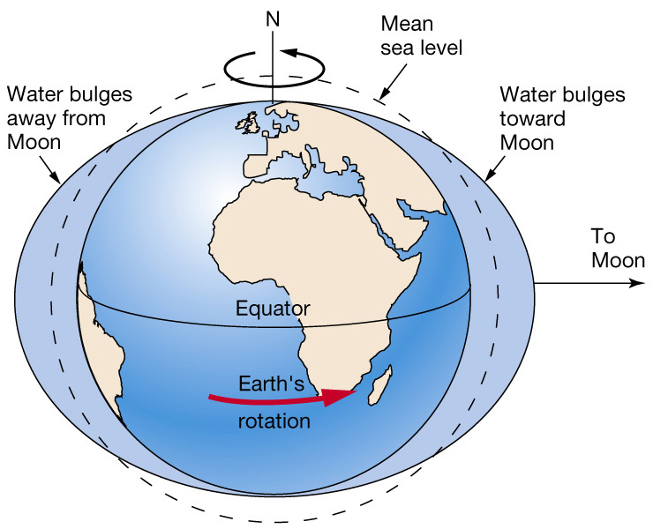
Tidal bulges
  Away from Moon on side of Earth opposite Moon
  Toward Moon on side of Earth facing Moon
Notes:
Earth rotates into and out of tidal bulges, creating high and low tides

Slide 3
Learning Objectives
Explain tides; distinguish gravity and tidal forces; explain two tidal bulges; connect tides to Sylt.

Slide 4
Opening Poll
Why does the sea disappear twice every day?
A Moon
B Rotation
C Wind
D Combination

Slide 5
Sylt at Low Tide
Insert photo: Wadden Sea exposed.
Discussion prompt.

Slide 6
Sylt at High Tide
Insert photo: flooded tidal flats.
What changed?

Slide 7
Astronaut Puzzle
Why do astronauts float although Earth's gravity is strong?

Slide 8
Free Fall
ISS, satellite, falling elevator.
Key concept: continuous free fall.

Slide 9
Think–Pair–Share
Discuss weightlessness with your neighbour (2 min).

Slide 10
Uniform Gravity
All parts accelerate equally → weightlessness.

Slide 11
Non-Uniform Gravity
Different accelerations → tidal forces.

Slide 12
Mini Exercise
Draw near side, centre, far side of Earth.

Slide 13
Tidal Forces
Tides are caused by gradients in gravity.

Slide 14
Near-Side Bulge
Stronger lunar attraction.

Slide 15
Far-Side Bulge
Weaker attraction than Earth's centre.

Slide 16
Why Two Tidal Bulges?
Students label the diagram.

Slide 17
Think–Pair–Share
Explain two high tides per day.

Slide 18
From Physics to the Wadden Sea
Tidal currents, flooding and drying.

Slide 19
Tidal Channels and Sediment Transport
Connection to coastal dynamics.

Slide 20
Group Exercise
What if there were no tides?

Slide 21
Group A
What happens to tidal channels?

Slide 22
Group B
What happens to sediment transport?

Slide 23
Group C
What happens to ecosystems?

Slide 24
Group D
What happens to Sylt?

Slide 25
Spring and Neap Tides
One simple explanatory diagram.

Slide 26
Climate Change and Future Tides
Sea-level rise, storm surges, risk.

Slide 27
Take-Home Messages
3–5 key concepts.

