Slide 1
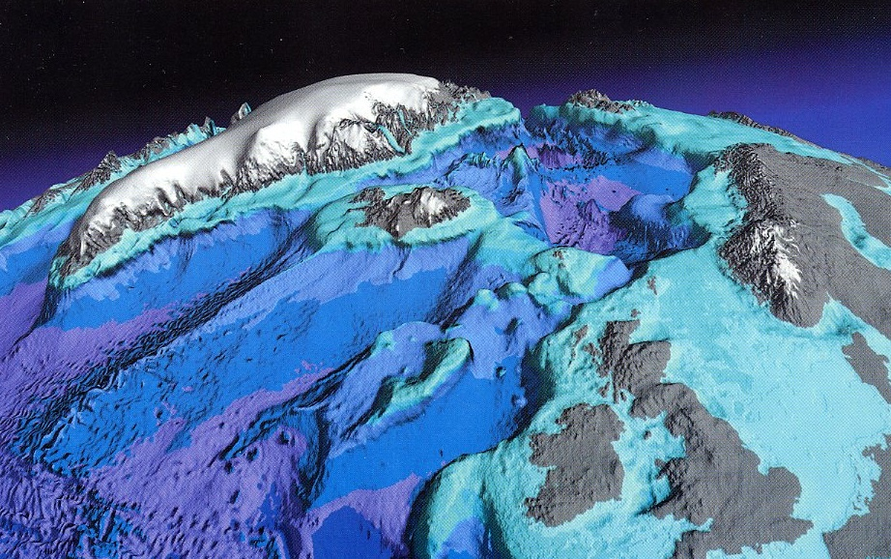
The coupling between Atlantic inflow and overflow in the Iceland-Scotland region
Bogi Hansen, Karin M. H. Larsen, Hjálmar Hátún, Svein Østerhus, Steffen M. Olsen
Greenland
Arctic
o
l
i
Nordic
Seas
o
n
C
g
Iceland
Atlantic inflow
Faroes
Shet-
land
Overflow
World Ocean
AGU, 2003

Slide 2
Monitoring
section
Iceland
Faroes
Faroe
Current
image:AGU 2003
AGU, 2003

Slide 3
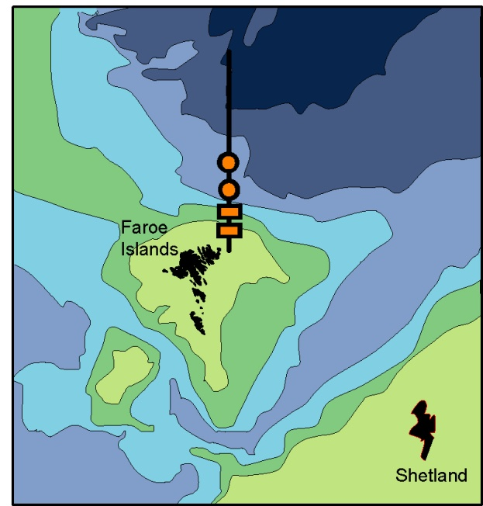
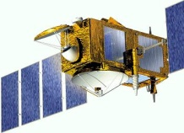
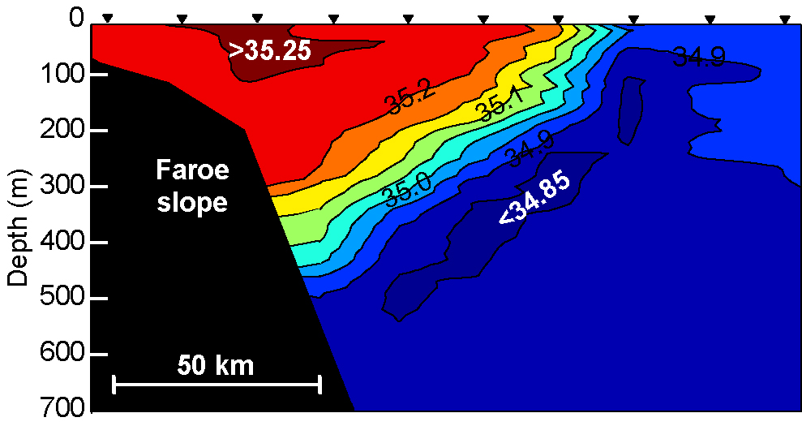
Atlantic water on monitoring section
Satellite altimetry
Atlantic
Arctic
Bottom temperature
Hansen et al., 2015:
CTD + ADCP + Altimetry => Volume transport 1993 – 2014
ADCPs: 1997-2015

Slide 4
Faroe
Current
Iceland
Faroes
Faroe-Shetland Channel
AGU, 2003

Slide 5
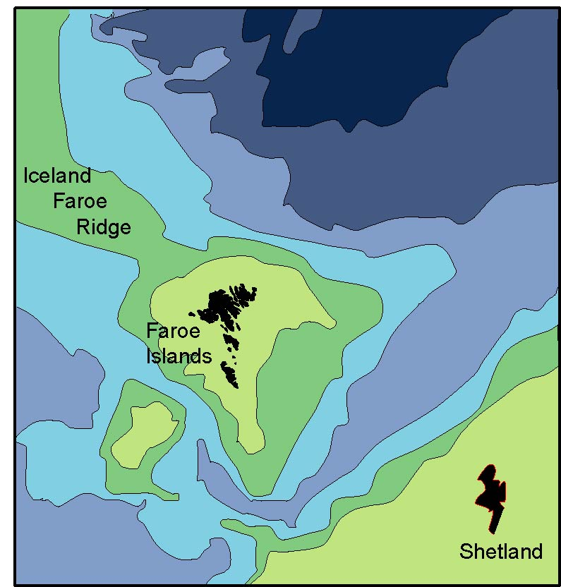
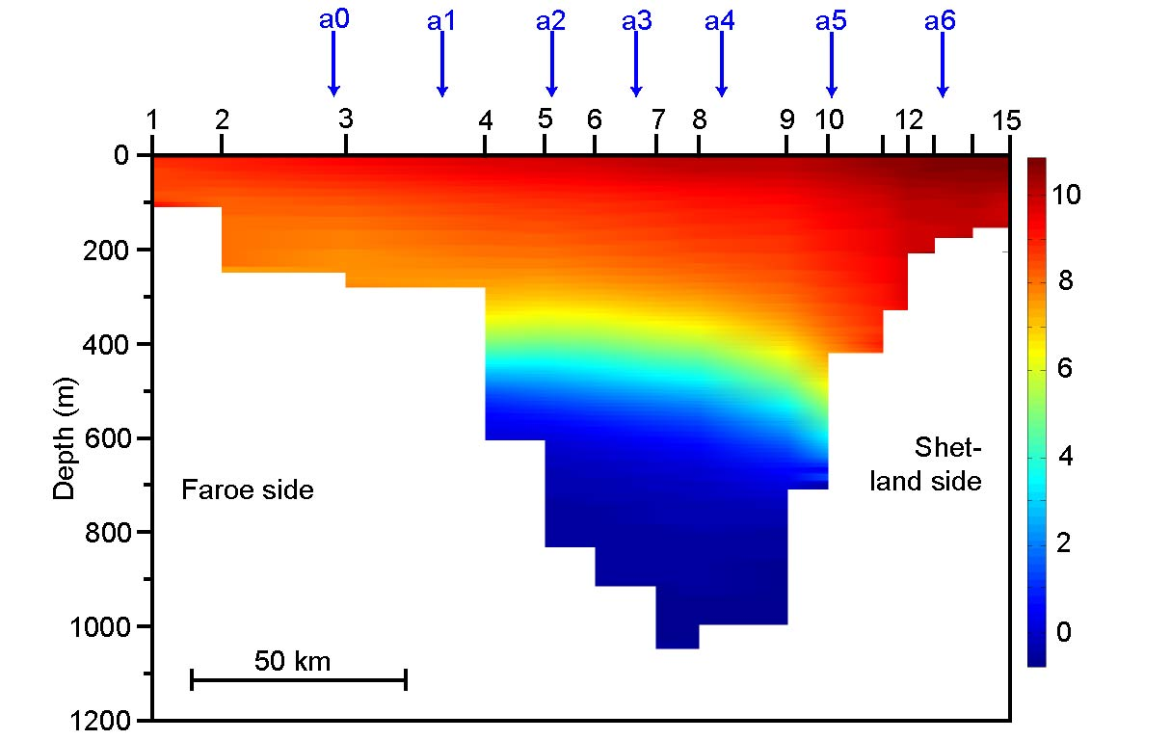
Faroe-Shetland Channel
Net flow = High inflow – High outflow
NACLIM
2015-2016
8 ADCPs
NACLIM
2014-2015
7 ADCPs
Highly variable flow structure
100 CTD sections
4 ADCPs: 1995 – 2009
+
5 ADCPs: 2009 - 2011
Altimetry: 1992 - 2011
Berx et al., 2013:
CTD + ADCP + Altimetry => Volume transport 1993 – 2011
Temperature

Slide 6
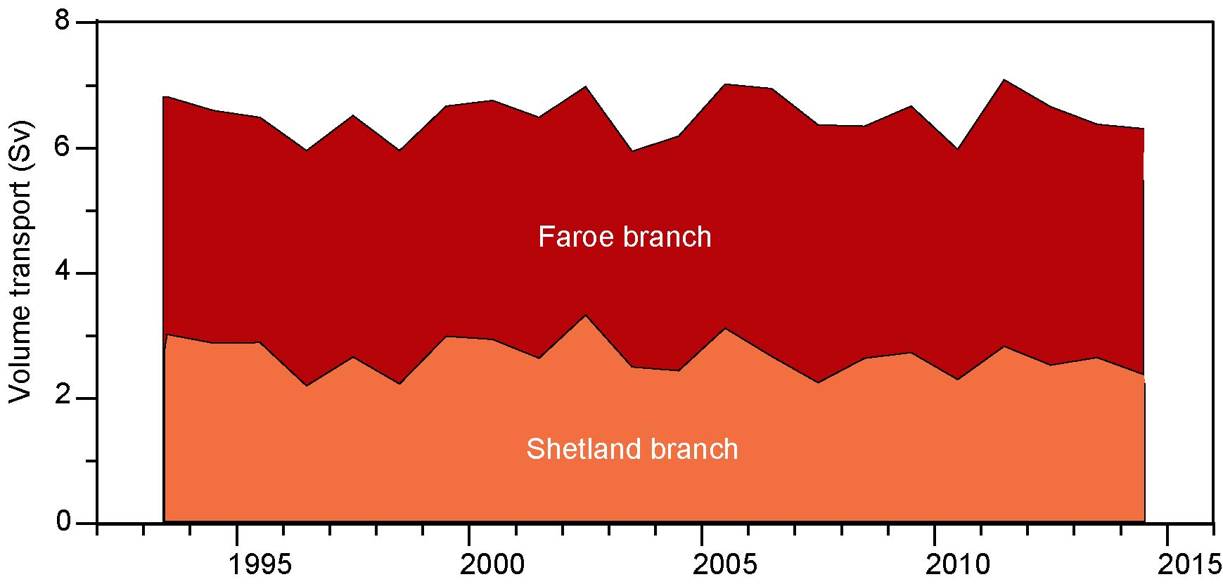
Iceland-Shetland inflow 1993-2014
(Shelfedge to shelfedge)
Iceland
Faroe branch
Average: 3.8 Sv
Total Iceland – Shetland trend +0.002±0.03 Sv/year
Faroes
Shetland branch
Average: 2.7 Sv
Faroe branch trend: +0.01±0.01 Sv/year
Shetland branch trend: -0.01±0.02 Sv/year
AGU, 2003

Slide 7
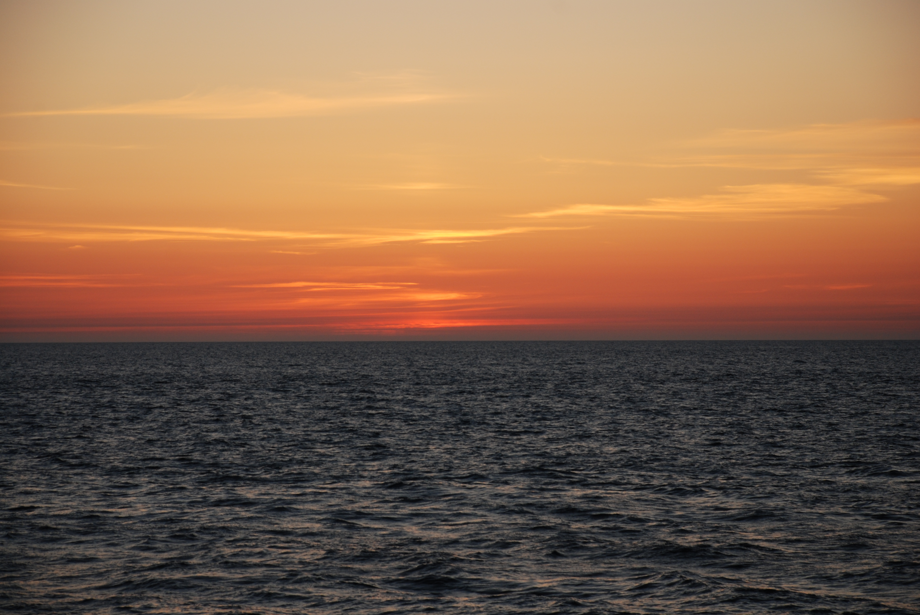
Heat- & Salttransport of the Faroe Current

Slide 8
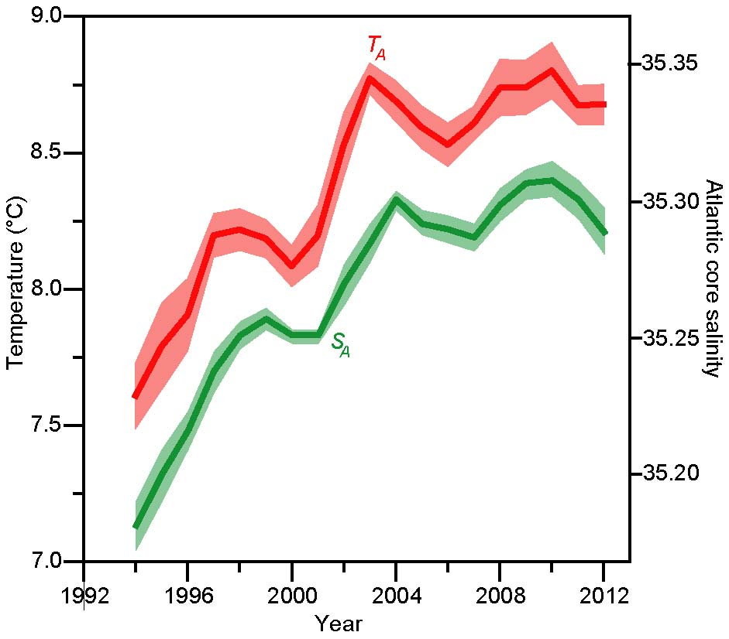
Atlantic water temperature and salinity
(Faroe branch)
SPG-shrinkage
T_{Atl}
3-year mean
1°C
S_{Atl}
0.1 psu

Slide 9
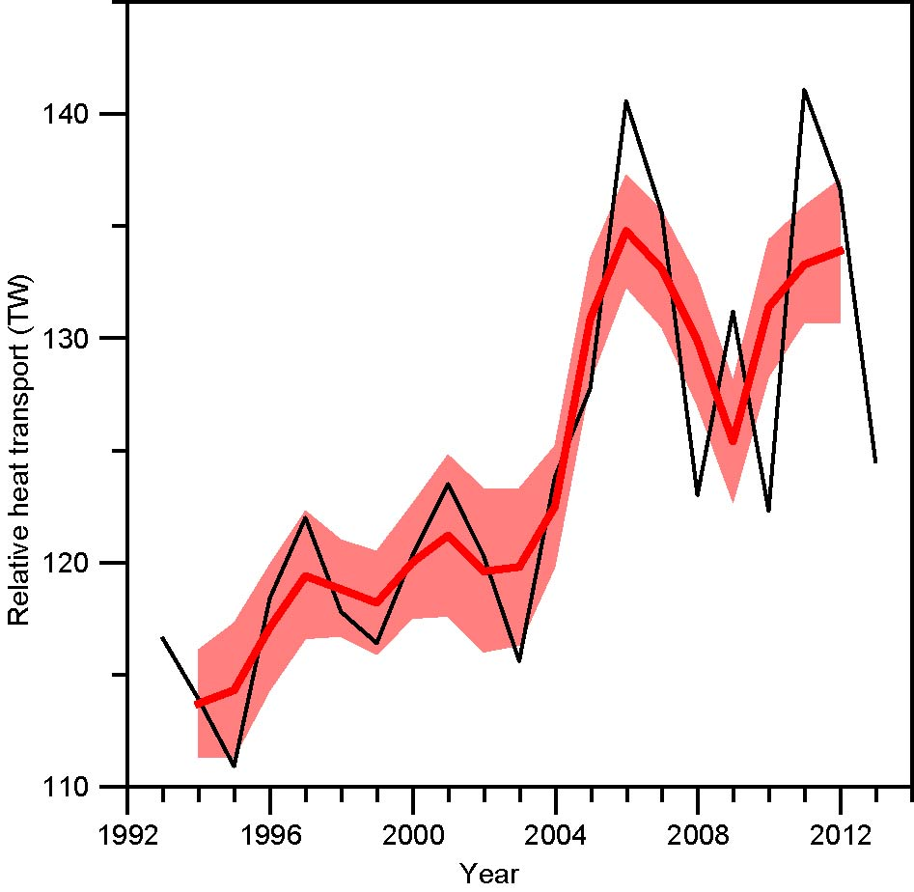
Heat transport of Faroe Current
(relative to 0°C)
Relative
Annual mean
± std. error
3-year mean
2014
20 year trend: 18±8%

Slide 10
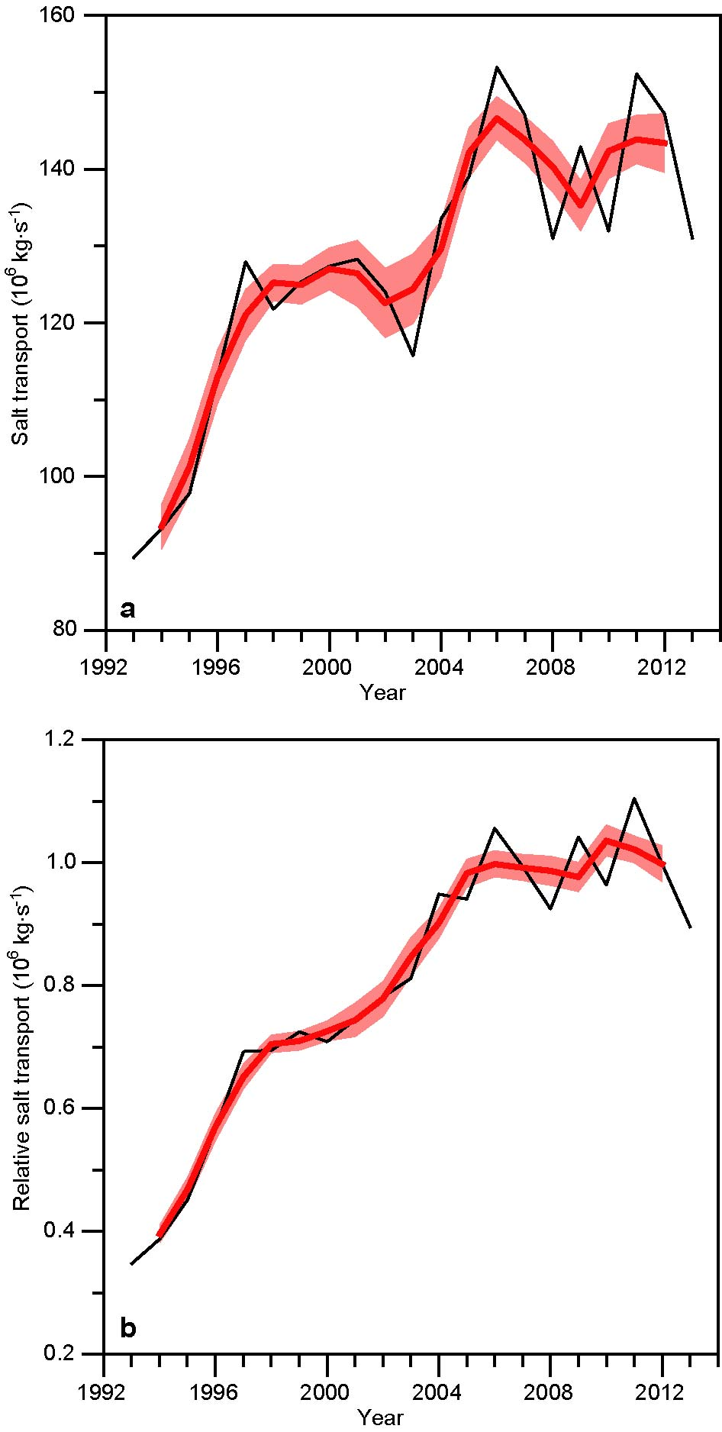
Salt transport relative to 34.95
(≈ FBC-overflow salinity)
20 year trend: 130±30%

Slide 11
Atlantic inflow
Temperature & Salinity
Faroe Bank Channel overflow

Slide 12
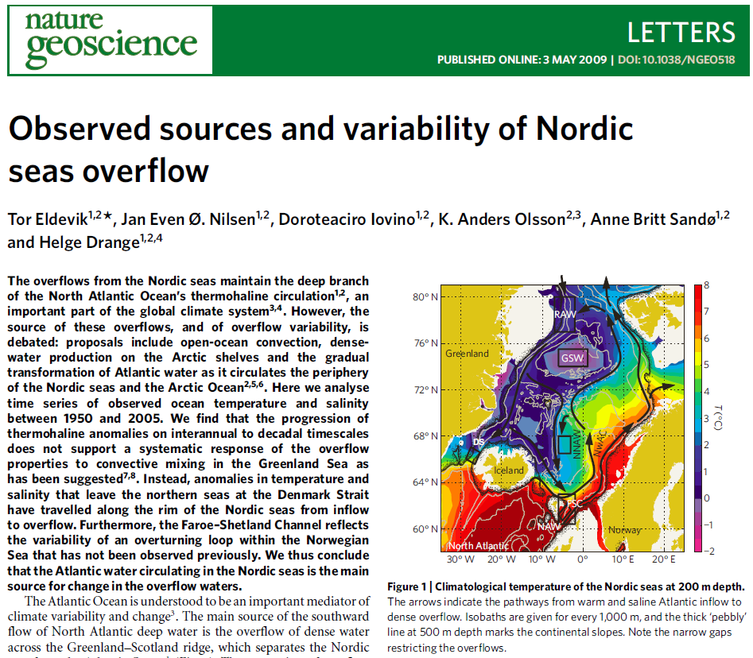
Based on salinity of FBC-overflow water:
This is indicative of a direct influence of the inflow on the overflow below, or, … an overturning loop local to the southern Norwegian Sea.
Separate and stronger evidence in favour of our suggested NAW -> NNAW -> FSC loop is provided by the fact that anomalies progress from NAW to the recirculating NNAW, and then from NNAW back to FSC (both lagged by 1 year).

Slide 13
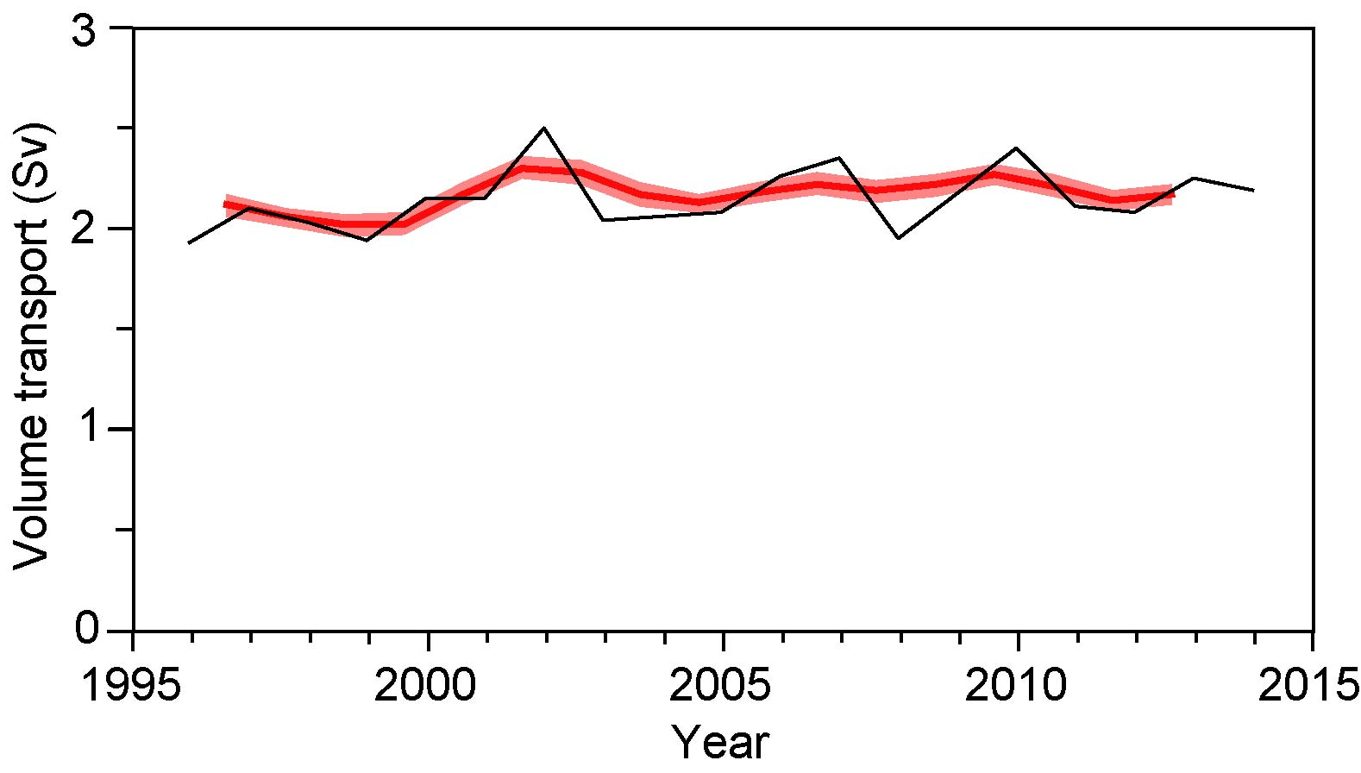
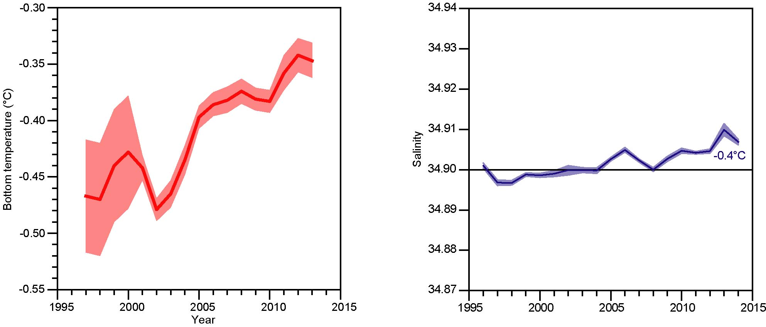
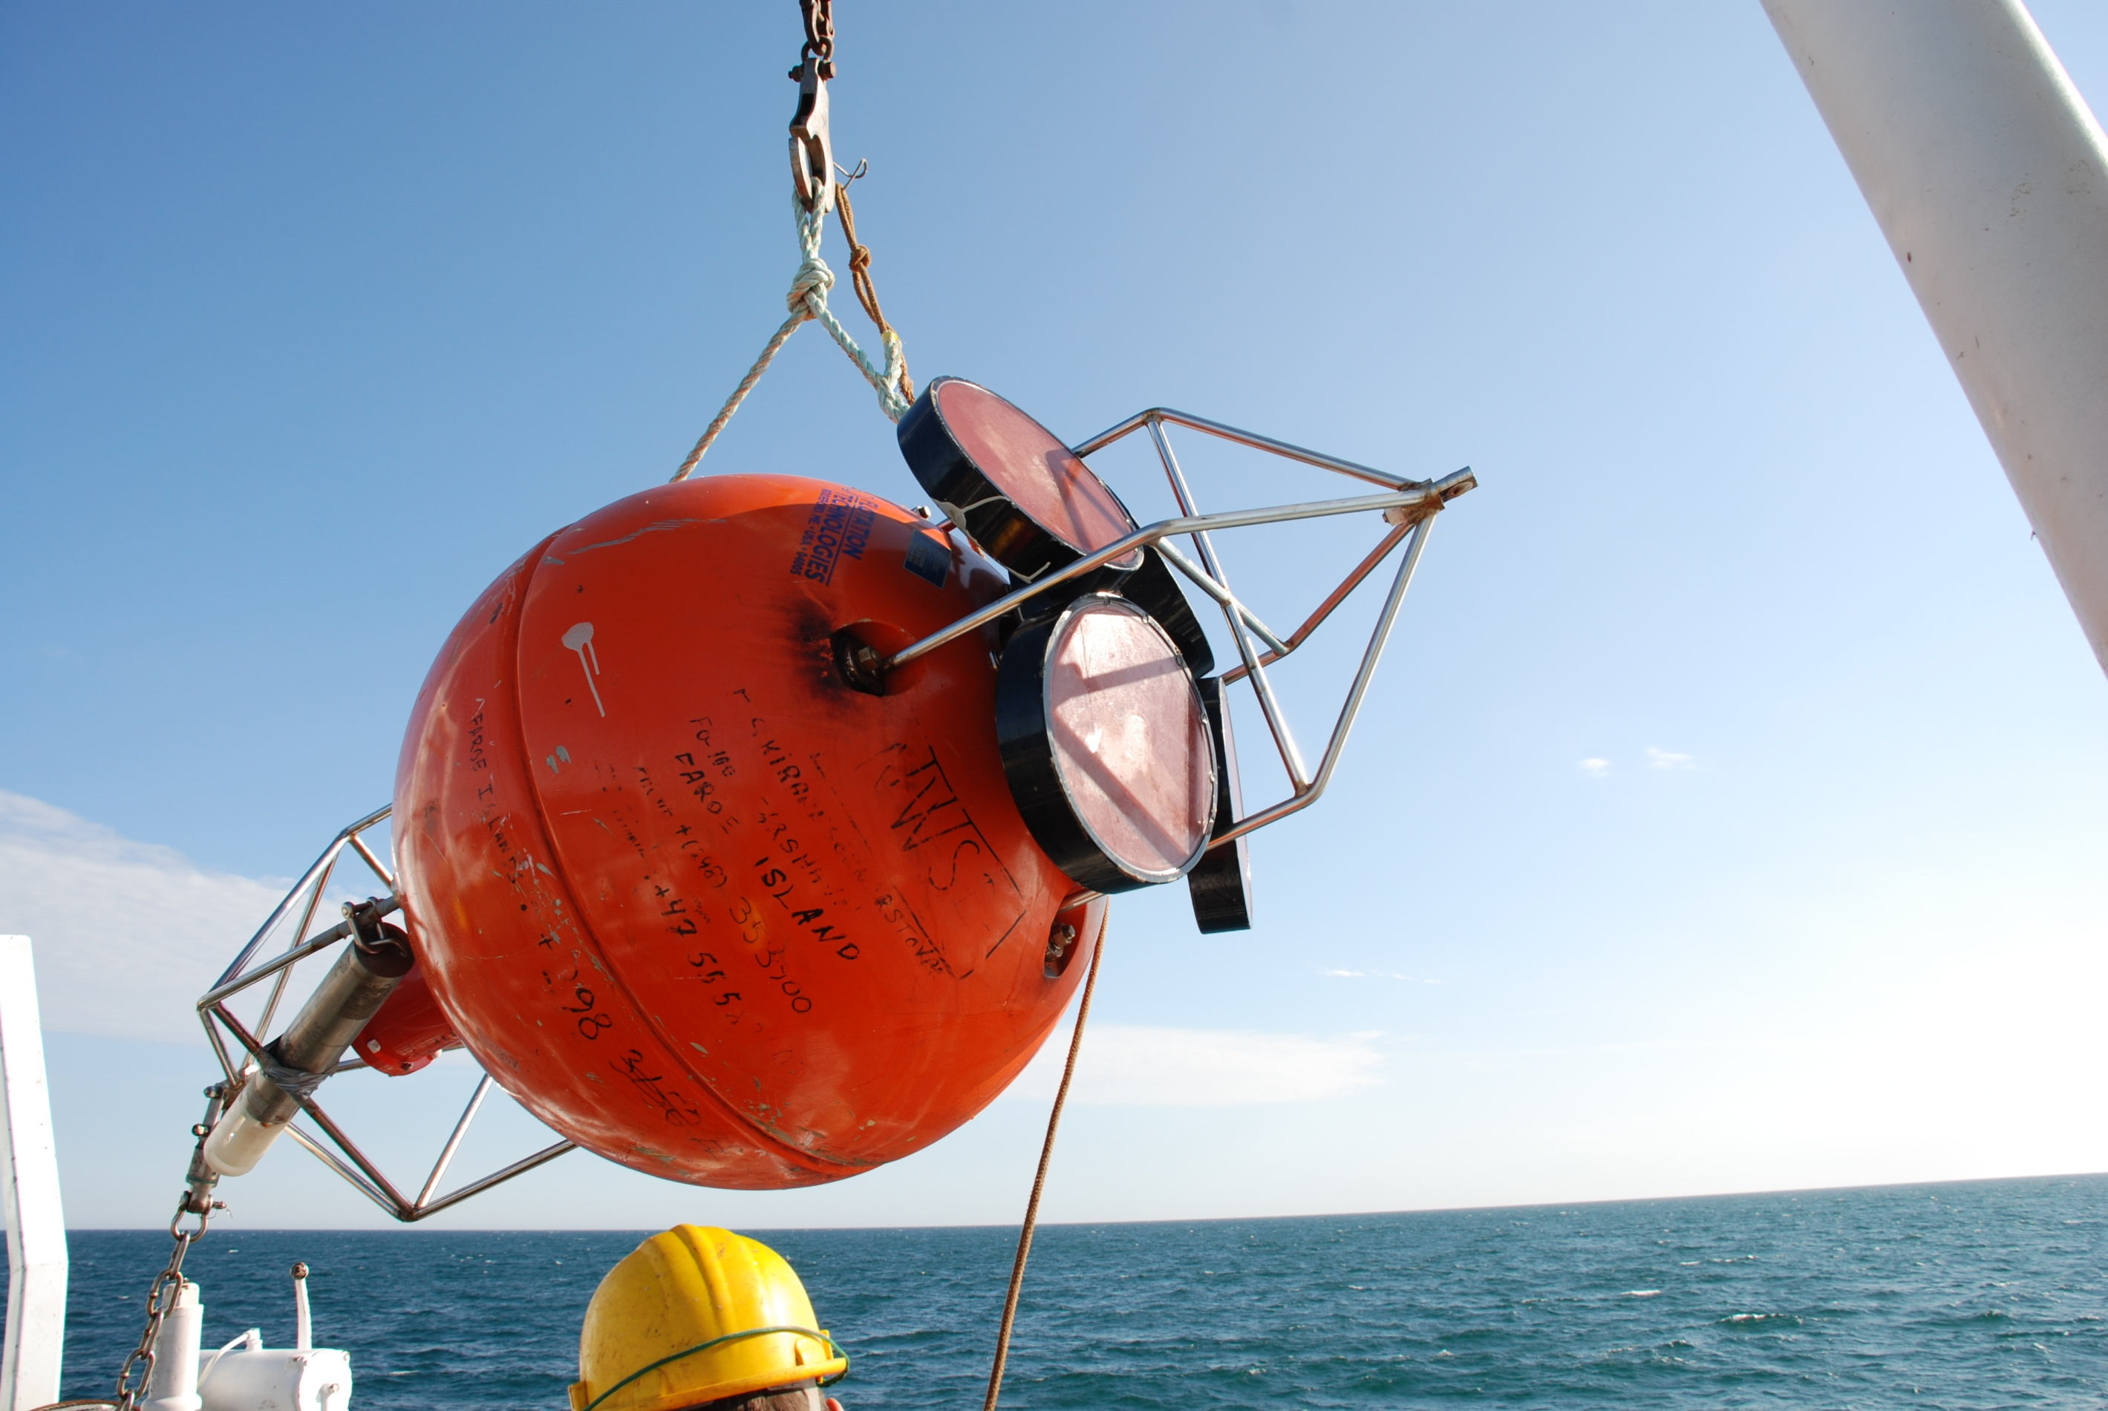
Greenland
Iceland
Faroes
No significant trend in
volume transport 1995 – 2015
Shet-
land
FBC-overflow
Arctic
FBC bottom temperature
FBC-overflow density
probably increased
0.1°C
AGU, 2003
The coldest overflow has warmed
But, also become more saline
World Ocean

Slide 14
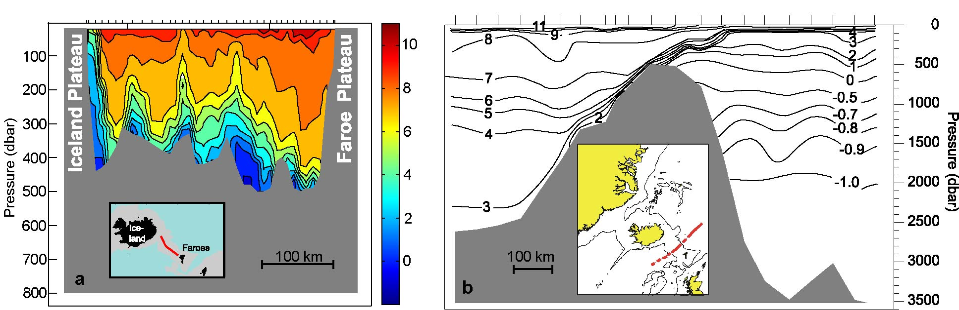
Coupling of inflow and overflow across the Iceland-Faroe Ridge
Iceland
Western Valley
Faroes
image:AGU 2003
Wilkenskjeld and Quadfasel (2005)
AGU, 2003

Slide 15
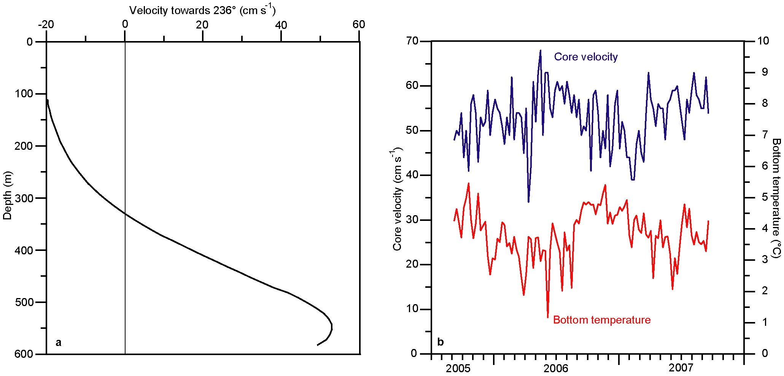
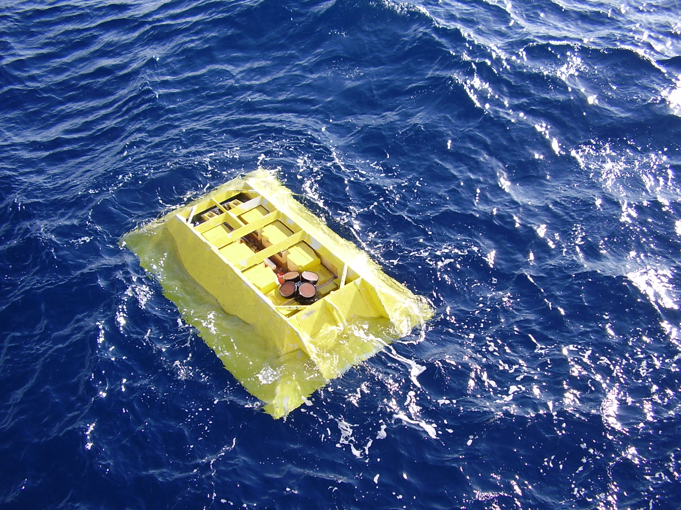
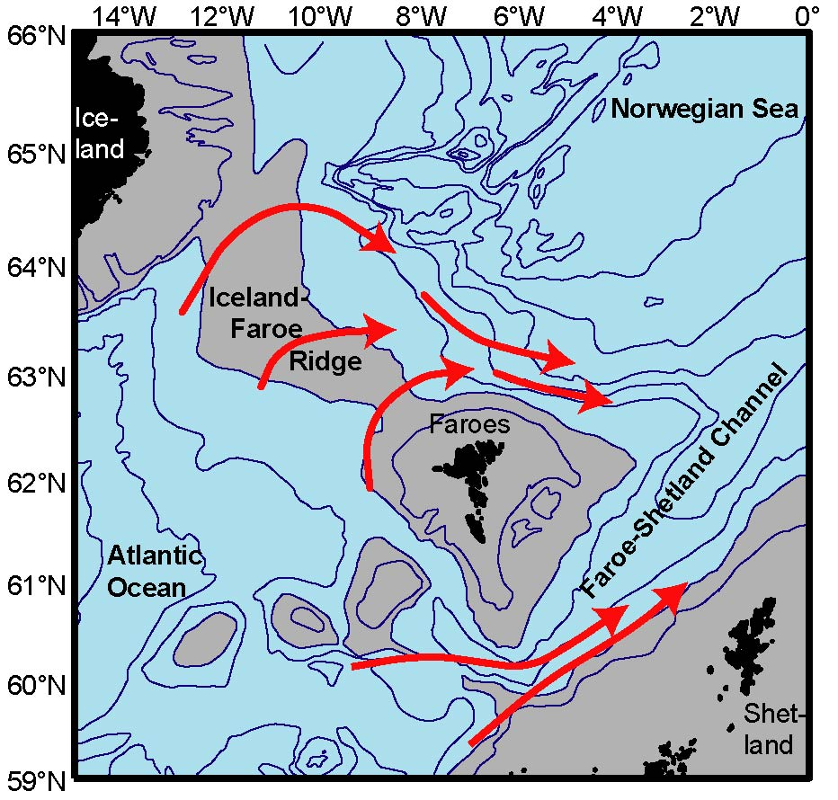
2-year ADCP at 600m depth downstream of Western Valley
(Detlef Quadfasel)
Average velocity profile
Western Valley overflow is variable, but persistent

Slide 16
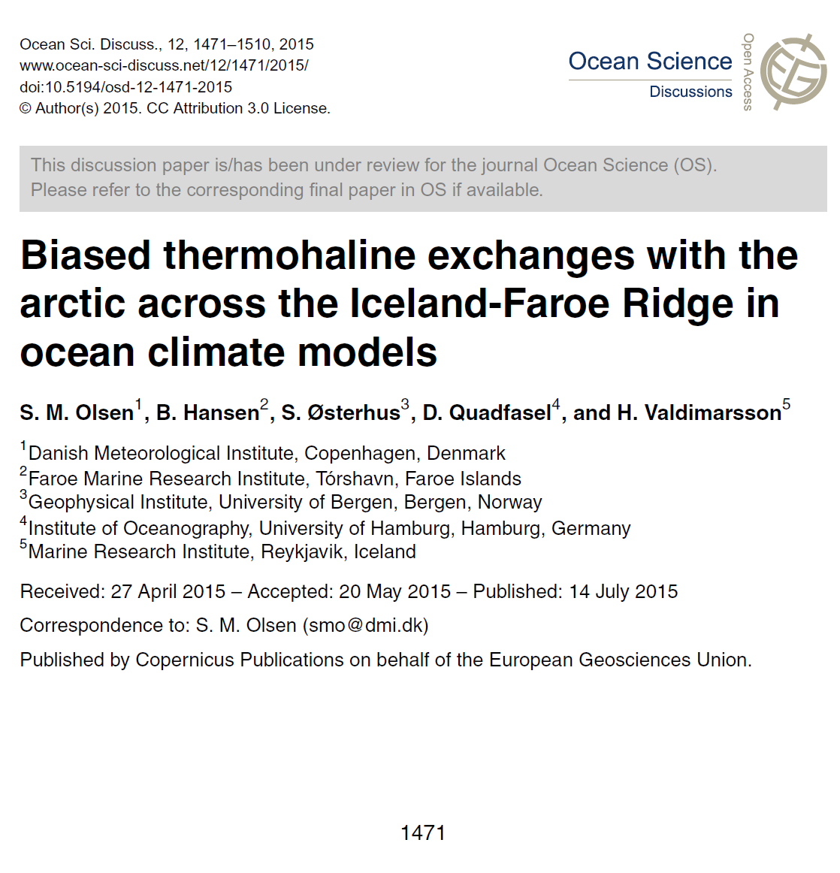

Slide 17
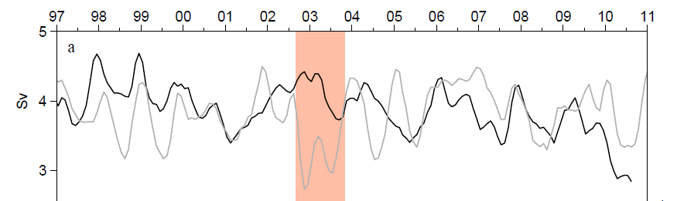

Observed and modeled
Faroe Current transport
Wilkenskjeld and Quadfasel (2005)
Modeled inflow = Net flow = Inflow – Overflow
Modeled Net flow may be fairly correct
Heat transport is difficult to model
Modeled
Observed

Slide 18
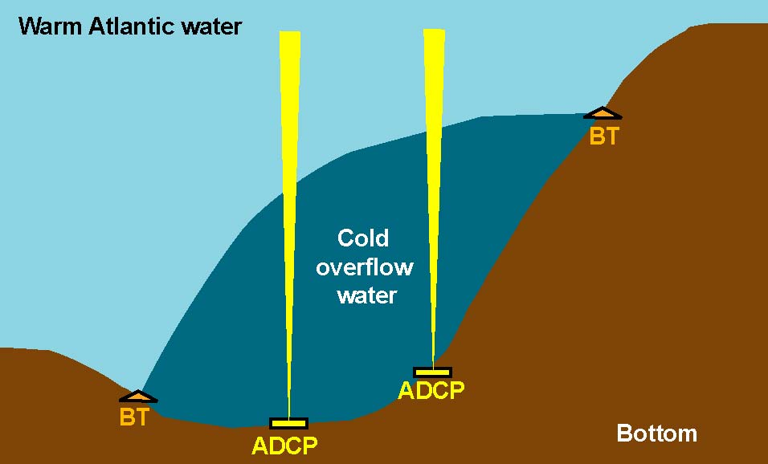
WOW Project
Western valley OverfloW
One year measurements

Slide 19
Future monitoring

Slide 20
Planned Faroe Current monitoring
Satellite altimetry
Atlantic
Arctic
Bottom temperature
No money
1 – 2 ADCPs + PIES ?

Slide 21

Western Valley overflow
One-year project
Iceland
No new moorings
Faroes
No Faroese moorings
FBC-overflow
2 ADCPs
4 Scottish ADCPs
?
NACLIM
The research leading to these results has received funding from the European Union 7th Framework Programme (FP7 2007-2013), under grant agreement n.308299 NACLIM www.naclim.eu
AGU, 2003

